Slide 1
Can You Believe Antenna Advertisers?
Neil Blaho
AA3EO

Slide 2
Its all about me!!!!!
AA3EO, Licensed since 1983, Extra Class.
BSEE 1982 Northeastern U., Electromagnetics.
38 years in aircraft aerospace.
(B-2, F-5, F-20, CH-47, CH-46, F-22, V-22)
Draper Lab., Lincoln Lab., Northrop Aircraft, Northrop B-2, McDonnell Douglas, Boeing Helicopters.
EMI, Antennas, Radar, RCS, Lightning, ESD, etc.
E3 Technology Group, Aircraft testing.
Associate Technical Fellow for Electromagnetic Environmental Effects.
Ham Radio fun: Designing and making antennas.

Slide 3
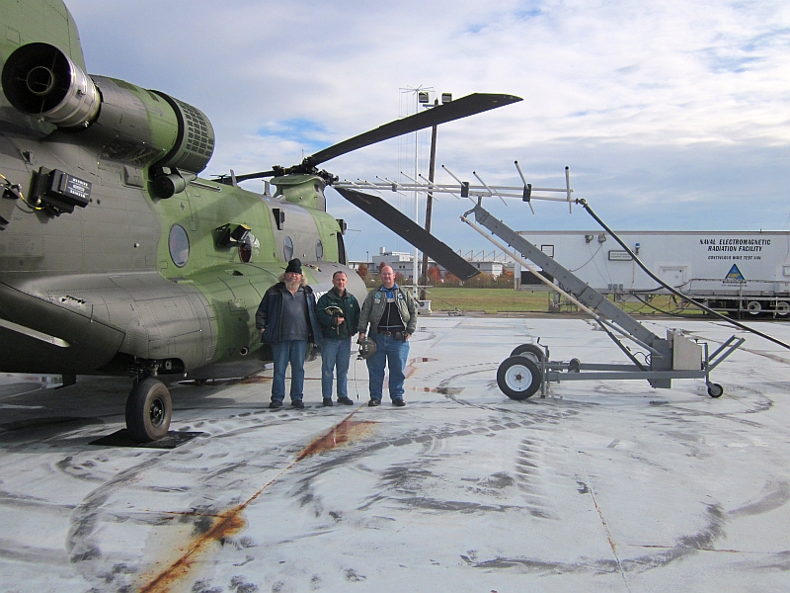

Slide 4
Yes we are that good!
Work the world with just a bed spring!
At least the ad said so!
You can tune up a bedspring and by golly it
will radiate like one!
Is your antenna really what you bought?
Seller terminological terminology.
What are real antenna parameters?

Slide 5
Typical Vendors
All antenna suppliers want to sell you their product.
Rule #1 of advertizing: Twist the truth!
Bet on non-technical types.
People will believe anything.
"Any sufficiently advanced technology is indistinguishable from magic.“
-- Arthur C. Clarke's Third Law of Predictions

Slide 6
My Favorite Terms
dBd (decibels relative to a dipole)
Groundwave
Hi-Gain. Not ‘high’ gain, but ‘hi-gain’.
Directionality.
“Low loss”, everything..…….(?)
“Balun matching”.
A balun does not match impedance, it reflects mismatches.
Allows balanced ladder line to feed an unbalanced coax .

Slide 7
Deciphering Jargon
dBd (decibels relative to a dipole)
Gain of an antenna relative to a dipole antenna.
Dipole is +2.15 dBi.
Usually use dBi; relative to an isotropic radiator with a gain of 0 dBi.
Makes you think an antenna is 2 dB better than it is.

Slide 8
Deciphering Jargon
Groundwave.
A groundwave is the return path of a monopole antenna.
Losses are based on the material: metal, air or dirt!
Waves travel in the air and above the ground!
Not sure about the benefits to a beam or a dipole antenna!

Slide 9
Who knows gain?
Many antennas have never been checked for actual gain.
Performance based on personal testimony.
Works great!!!
Has happened on aircraft too.
“Gain” is the apparent concentration of RF energy in a desired direction relative to an isotropic radiator.

Slide 10
Typical Antenna Gain
Monopole +1 dBi
Dipole +2.15 dBi
Two element array +5 dBi
Three element beam +7 dBi
Log periodic +8 dBi
Multi-element Yagi +12-14 dBi

Slide 11
Scaled Antennas
Designed to fit in a small space.
“Work wonders for DX!”
May the sunspots be with you……
What is the real gain, and losses?
Size matters!
Loading coils and capacitance hats add losses.
No free lunch in the RF world.
RF gotta go somewhere.

Slide 12
Antenna Aperture
“An antenna is only as big as its aperture.”
Also proportional to directionality.
Gain = 10 * Log (aperture)
Effective aperture or directionality.
Scaled antennas have scaled gains.
Yes, size really does matter!

Slide 13
Example of Scaled Antenna
A VHF-FM monopole antenna for 30-88 MHz would be about 98.4” tall.
Too big for an aircraft!
A/C antenna is only 14.5”.
Needs a built in tuner.
What is real gain?
Ideal gain = -10 log (scaled size)
Therefore: +1 - 10 log (14.5/98.4) = -7 dBi
Less tuner/loading loss and it becomes -12 dBi.
94% down from full size whip.
“Tested on 10’ dia. groundplane.”

Slide 14
Gain of Scaled HF Antenna?
MFJ 36” diameter loop for 10-30 MHz
Full scale is
10 MHz loop should be 31’ dia.
30 MHz loop should be 10’ dia.
Gain should be 1 dBi.
Scaled gain:
10 MHz gain would be -9 dBi
30 MHz gain would be -4 dBi
Maybe 1 dB less for tuner losses.
Tradeoff of gain for small size.
Sharp tuned means narrow bandwidth.

Slide 15
Gain of Scaled Beam Antenna?
AES three element trap beam
Claim +8 dBd (+10 dBi? +7 dBi is ideal)
Calculate aperture (scaled) size.
10 MHz gain would be +8.5 dBi*
15 MHz gain would be +6.5 dBi
20 MHz gain would be +5.5 dBi*
Maybe up to 3 dB less for total trap losses.
*Element spacing was not scaled; gain questionable.

Slide 16
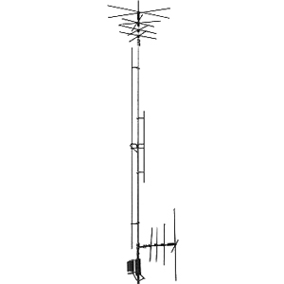
Is It a Dipole or Monopole Antenna?
MFJ-1796 40/20/15/10/6/2 Meters Halfwave Vertical Antenna
Actually it is a highly loaded dipole situated vertically.
Gain? Umm, yes, but not positive. -6 dBi to -16 dbi?
Capacitance hats, coil traps, loading coil, parasitic elements.

Slide 17
The Ersatz G5RV
Rated for 10-40 meters. (30-7.5 MHz) ($40-$50)
Originally designed for 20m.
102’ dipole
Fed with 30’ 450 ohm ladder line
1:1 balun to 50 ohm coax. (no balun?)

Slide 18
Where Did It Come From?

Slide 19
G5RV Math?
How does it work?
102’ dipole, natural resonance at ~5 MHz. (60m band?)
Harmonically 15, 25, 35 MHz.
Ladder line could be thought of a ¼ wave stub match for ~7.28 Mhz. (or 21.84, 36.4 MHz) (allow for 0.91 Vf)
Z.stub = (Z.line * Z.ant)^1/2
Z.line = 50 ohms, Z.stub = 450 ohms.
Therefore: Z.ant = 4050 ohms. (?)
No, the impedance of a resonant dipole is ~73 ohms.
Stub theory fails…..
10m = 2532 ohm, 20m = 93 ohm, 40m = 302 ohm, 80m = 31 ohm
VSWR: 10m = 50:1, 20m = 1.8:1, 40m = 6:1, 80m = 1.6:1
Note: 10m & 40m band would be tough to resonate.
Not designed for 80m but it could work with low gain.

Slide 20
G5RV Math
Where is the gain at 20m?
50 Ω Coax to 450 Ω ladder line is a 9:1 mismatch? 36% Tx
Ladder line to G5RV 93 Ω is a 4.8:1 mismatch? 56% Tx
Mismatch losses of 80%
Effectively an 18:1 mismatch?
Measured VSWR > 10:1
Gain of -7 dBi at best @ 14 Mhz.
35% range of standard dipole
Other band estimates:
10m ~-9.1 dBi, 40m ~1 dBi, 80m ~-8 dBi,
The feedline radiates!
Umm, no. Only with a bad VSWR!

Slide 21
???? Enigma of G5RV ????
Why is it used?
Any wire antenna will offer some use.
Personal testimony of use.
Needs a good tuner.
Tuner maximizes low efficiency dipole.
Sometimes people just buy stuff.
Meets original design goal.
Fit in the garden space available.
Work other bands if it can.
“Just had to work somehow.”
~ 1950 had the 4th highest sunspot cycle.
1960 had the highest ever.

Slide 22
What Would I Do?
Make a five band full size fan dipole.
A balun can help; not needed.
Cheap antenna.
No loading coils or stubs.
Guaranteed +2 dBi performance!
Antennas are a compromise of size, performance, installation and cost.
The best one for you is the one that works.

Slide 23
W5GI Mystery Antenna
Claims to work 10-80m with gain!
G5RV inspired antenna.
A dipole with traps.
Coax and ladder line feed.
“used the world over by thousands of amateurs”.
Low VSWR!

Slide 24
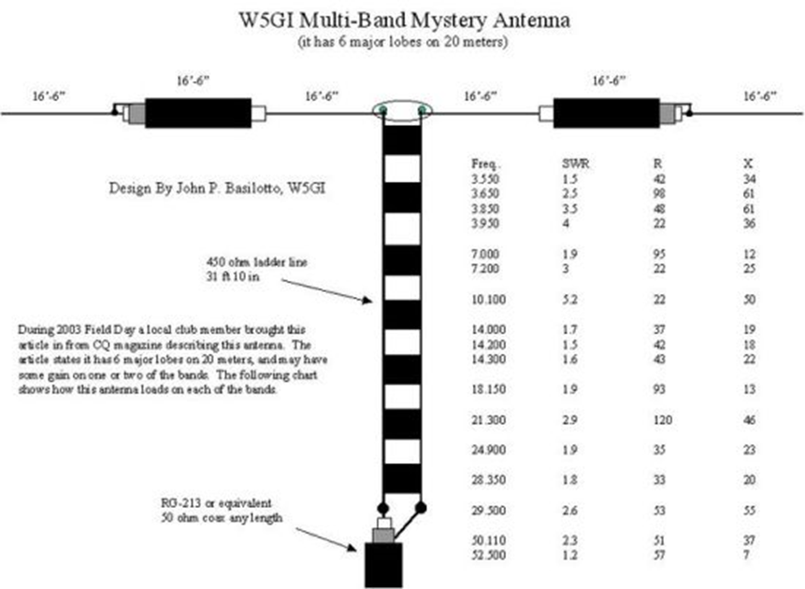
W5GI Mystery Antenna
Antenna details.

Slide 25
W5GI Mystery Antenna
99’ dipole with traps.
Traps aren’t traps, they are cancellers.
RF backtracks.
Not a collinear array as claimed.
Included analysis is less than wrong.
Coax and ladder line feed.
Guaranteed 9:1 mismatch.
Mismatch at the antenna is high as well.

Slide 26
W5GI Mystery Antenna
Does it work?
Any wire will work……
Only if you think so.
Worth reading owenduffy.net rebuttal to design.
An oversold idea.
I’m saving my money.

