Slide 1
W6HA Repeater UPDATE
MIKE DARLING N6MHD
BRIAN JOHNSON AB6UI

Slide 2
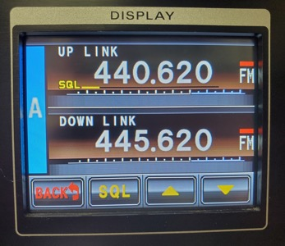
W6HA REPEATER OVERVIEW
Location: RTX building R01, Hughes Way & Imperial Hwy, El Segundo, CA
445.620 MHz, -5 MHz offset, PL Tone 127.3Hz
Recently installed the clubs new Yaesu DR-2X
Analog FM and Yaesu System Fusion (C4FM)
Transmit power: 20 Watts (medium power)

Slide 3
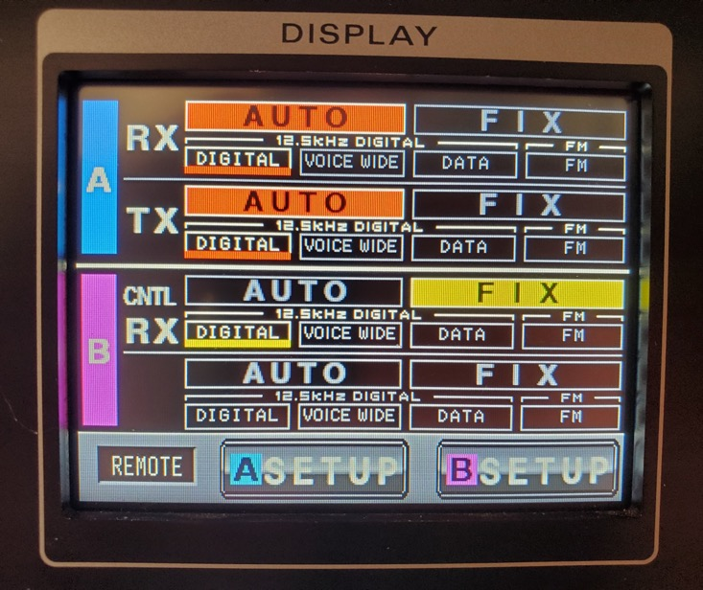
Yaesu system fusion and AMS
Yaesu System Fusion/C4FM is a digital mode
Requires a Yaesu radio capable of C4FM
Analog FM is still the best for weak signals/handhelds with poor line of sight to the repeater
DR-2X repeater is set to auto mode select (AMS) to work in either analog or digital
Repeater will not repeat a digital signal as analog FM, or convert analog FM to digital C4FM
Analog FM radios should be set to “tone squelch” for transmit and receive
YSF compatible radios should be set to AMS to hear both analog FM and C4FM

Slide 4
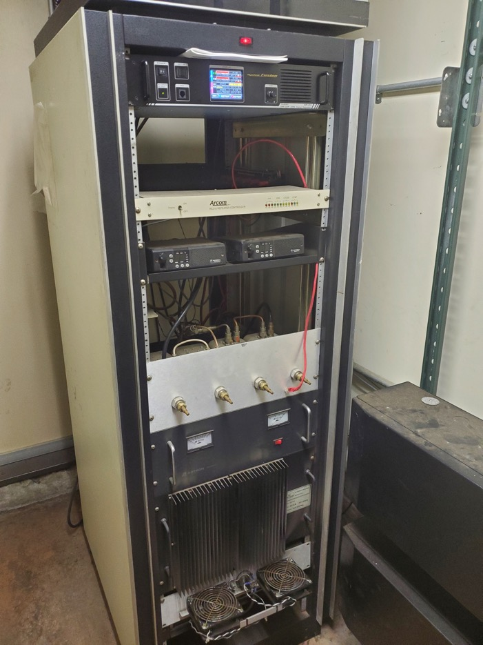
What’s in the rack?
New Repeater:
Yaesu DR-2X
Cavity Duplexer
12VDC Power Supply
Old Repeater:
Arcom RC210 Controller
Motorola Radius GM300 Radios
Cavity Duplexer
12VDC Power Supply
RF Power Amp
Cooling Fans

Slide 5
DR-2X CONNECTIONS
70cm Antenna
2m control Antenna
PASS 445.600
NOTCH 440.600
PASS 445.600
NOTCH 440.600
PASS 440.600
NOTCH 445.600
PASS 440.600
NOTCH 445.600
Cavity Duplexer
X18
Rx Preamp
DR-2X Repeater
120VAC

Slide 6
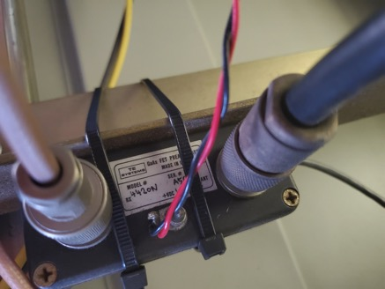
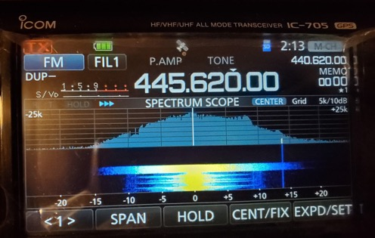
WHAT’S NEXT?
Repeater sensitivity
DR-2X receiver performance is better than the Radius GM300, basically a FTM-400 radio in a rack chassis
Squelch hysteresis set to max – helps weak stations keep the repeater open
Reinstalled receive preamp (gain x18) - completed 5/11/2021
Squelch tweaks – ongoing
Squelch burst at end of transmissions is annoying
Squelch tail is set to 0ms
Can turn up the squelch on repeater input, but weak stations may be impacted
Firmware update – soon
Improves AMS mode performance in noisy environments

Slide 7
WHAT’S NEXT? (continued)
FVS-2 Voice Module – soon
Will enable automated voice message playback for announcements (not repeater voice ID)
Courtesy tone options?
DR-2X does not have a built in tone generator
Reprogram Arcom RC210 repeater controller for tone generation only & build a new interface cable, or build a new tone generator

Slide 8
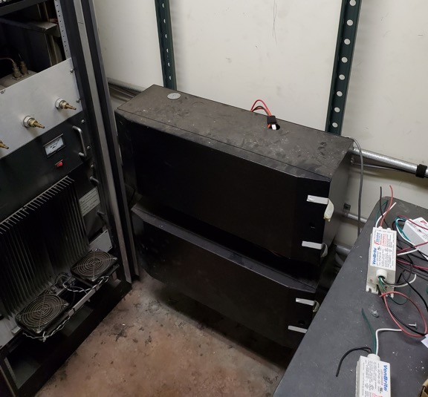
WHAT’S NEXT? (continued)
Backup Power
Building R01 has backup generator system (~24 Hours)
DR-2X can be powered from either 120VAC or 12VDC, with automatic switching to DC when power is lost
DR-2X will switch to low power mode when running on DC power
Battery boxes on wall are not currently hooked up, need to test gel cells

Slide 9
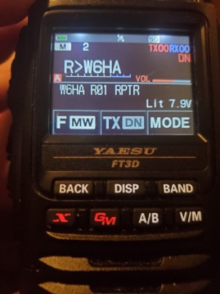
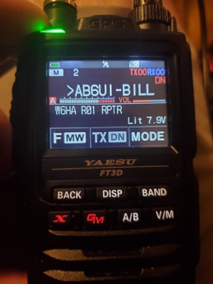
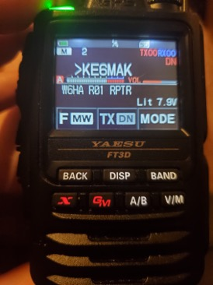
WHAT’S NEXT? (continued)
Yaesu Wires-X Internet Linking – Tested
Works in C4FM/digital mode only
External Wires-X node is linked to the repeater (AB6UI)
Connect to W6HA repeater while traveling via hotspot or another YSF digital repeater
Check into weekly digital nets from almost… anywhere
Connect to other Wires-X rooms: https://www.yaesu.com/jp/en/wires-x/id/active_room.php
Wires-X Button!

