Slide 1
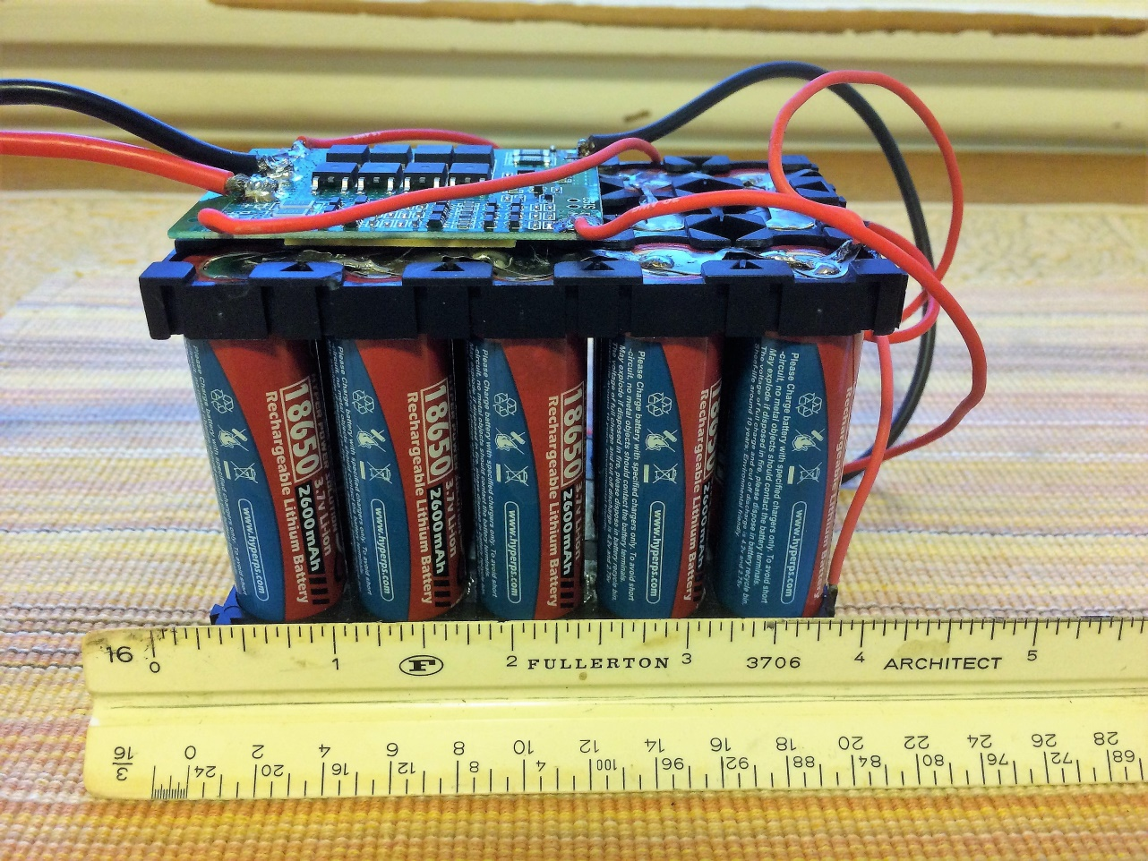
The “Brian-O
Battery
By: Brian Johnson, AB6UI 14 Nov 2017

Slide 2
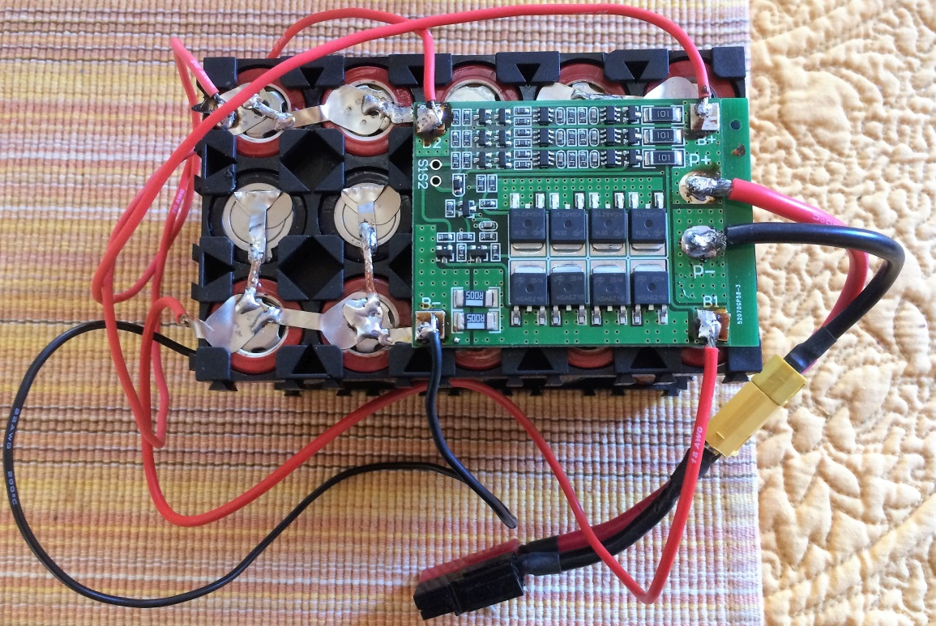
Before you buy A ”Bioenno Power” battery For $150
Consider the Brian-O:
15 X 18650 Lithium batteries
16 for $42.37 (eBay)
Balance Charge Control Board
1 @ $2.18 (eBay)
15 position plastic shell
2 for 1.97 (BangGood)
Total price $46.52
12V 25-AMP 13,000 mAh

Slide 3
What you need to get started
15 18650 Li-ion batteries
With solder tabs
Charge controller board
Plastic battery shells
Misc wire and connectors
And your soldering skills!

Slide 4
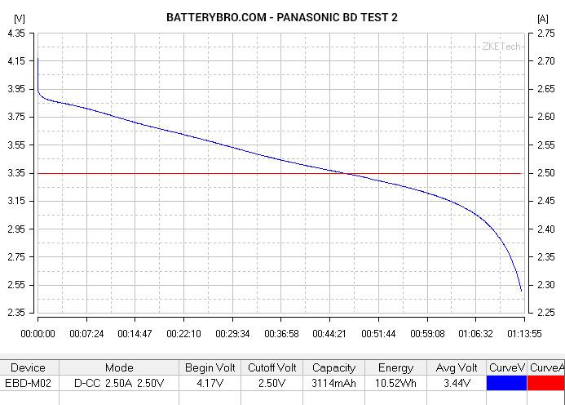
18650 Li-Ion Battery
Make sure you get ones WITH SOLDER TABS!

Slide 5
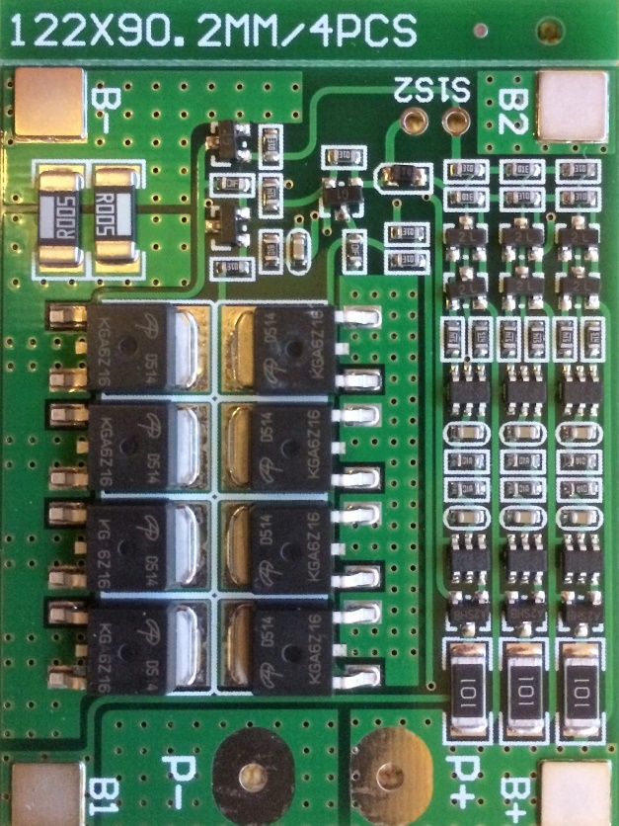
Charge controller PWB
3S 11.1V 25A w/Balance 18650 Li-ion Lithium Battery BMS Protection PCB Board Model:HX-3S-FL25A-A Size: about 56mm*45mm*1.2mm Over voltage range: 4.25-4.35v±0.05v Over discharge voltage range: 2.3-3.0v±0.05v Maximum operating current: 0-25A Maximum transient current: 34-40A Quiescent current: less than 30uA Internal resistance: less than 100mΩ Working temperature: -40---+50℃ Storage condition: -40-- +80℃ Effective life: more than 30000h Short circuit protection: Yes, delayed self recovery

Slide 6
Putting it all together
Plastic battery shells are available from BangGood
PCB can be mounted directly to the side of the pack
Add a connector of your choice
I prefer XT 60 over Power Pole
Less expensive
No special crimp tool required
Made from high-temp nylon with gold-plated spring pins or sockets molded in. The shape of this generic XT60 prevents reverse polarity, and when plugged in the connection is super-solid.

