Slide 1
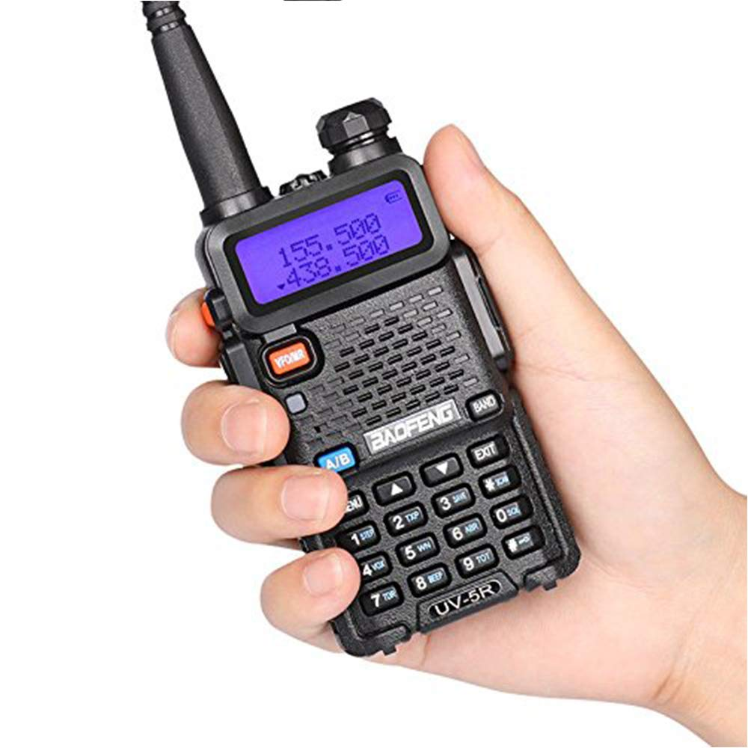
The Baofeng
UV-5R
By: Brian Johnson, AB6UI 5 July 2020

Slide 2
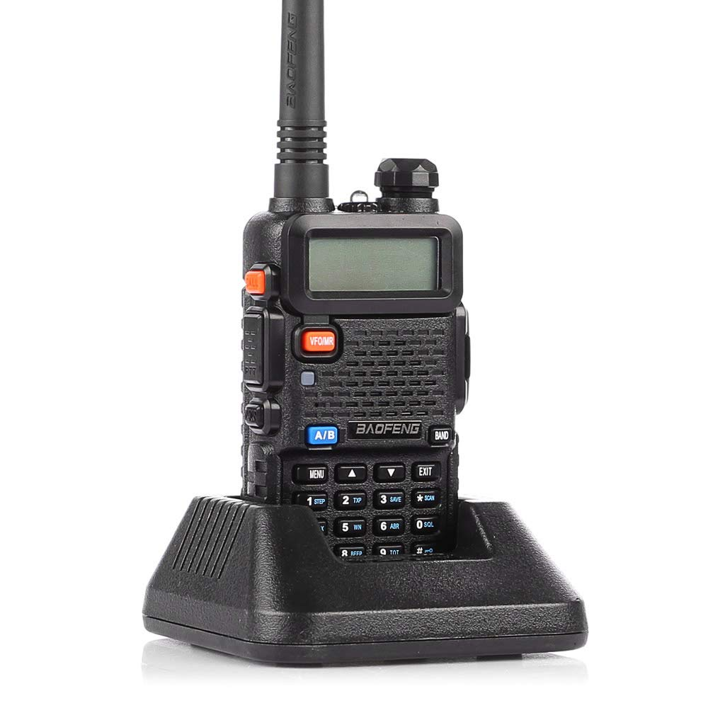
Before you buy an expensive UHF/VHF Radio
Consider the Baofeng UV-5R
Works on 2m & 70 cm Ham Bands
With your ham license
Plus
Covers all VHF Marine Frequencies
Covers FRS/GMRS & WX frequencies
Total price $23.81
Free Shipping for Amazon
Prime Members

Slide 3
What you get in the box
1 x BaoFeng UV-5R
(VHF136-174MHz / UHF 400-520MHz) Two-Way Radio
1 x 7.4V 1800mAh Li-ion Battery Pack
Antenna 136-174/400-479.995Mhz
Earphone Mic/Headset
Belt Clip
Hand Strap
Desktop Charger

Slide 4
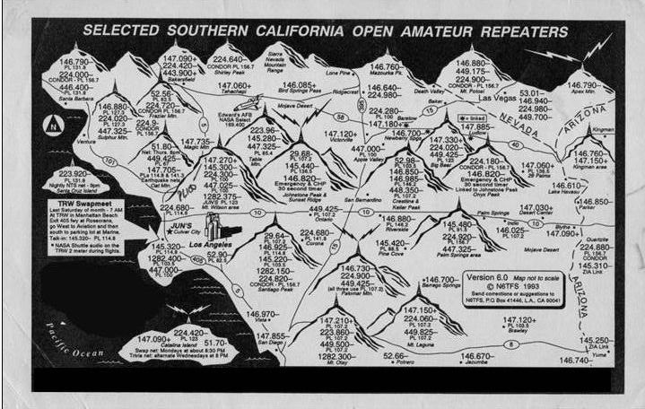
VHF/UHF Repeaters
Repeater Guide

Slide 5
VHF Marine CH Freqs

Slide 6
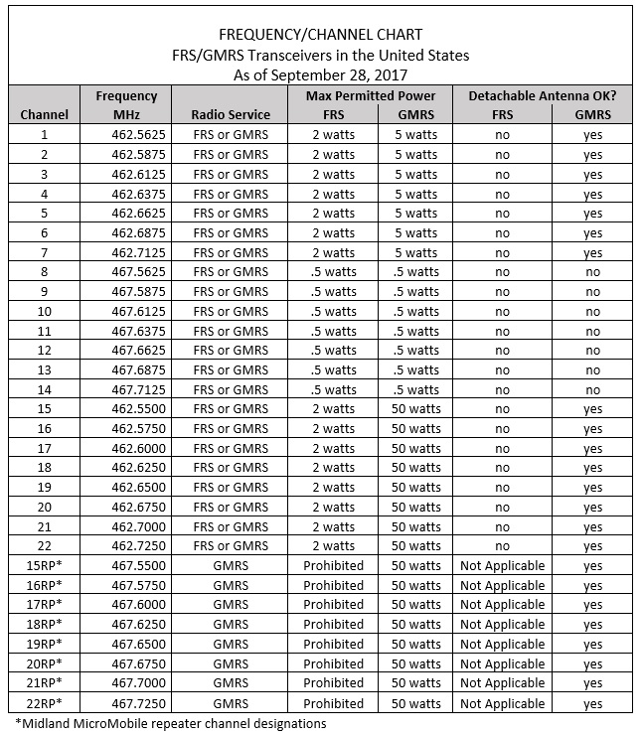
Weather CH Freqs
Nationwide Station Listing Using Broadcast Frequencies
162.400 MHz | 162.425 MHz | 162.450 MHz | 162.475 MHz | 162.500 MHz | 162.525 MHz | 162.550 MHz
FRS CH Freqs

Slide 7
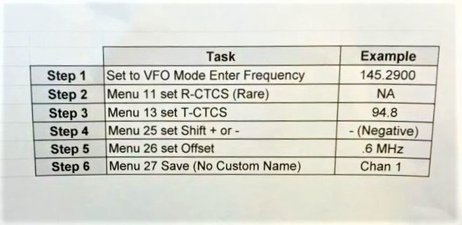
How to program the UV-5R from the front keypad
Six simple steps!

Slide 8
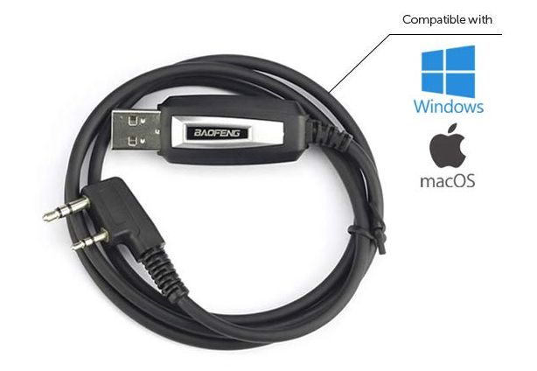
Programming with “Chirp”
Demo of Chirp Programming

Slide 9
High quality and in-depth User Manual for Baofeng radios
Chinese Radio Project

Slide 10
Secret Shortcuts
This little “carrot” indicates what band you are on. Press the “blue” A/B button to switch
Pressing the * key will switch to reverse
Pressing the # key will switch power levels

Slide 11
Recommended accessories
Better “rubber duck” antenna
Genuine Nagoya NA-771 VHF/UHF Antenna
Amazon $19.98
Larger battery
UV-5R High Capacity (3,800 mAh)
Amazon $15.75
USB Programming Cable
Tenway USB Programming Cable for Baofeng Radios
Amazon $9.99
“Mobile Mag Mount”
Tram 1185 Amateur Dual-Band Magnet Antenna
Amazon $22.50
Please note: you will need an SMA Female to UHF Female adaptor

Slide 12
Questions?

