Slide 1
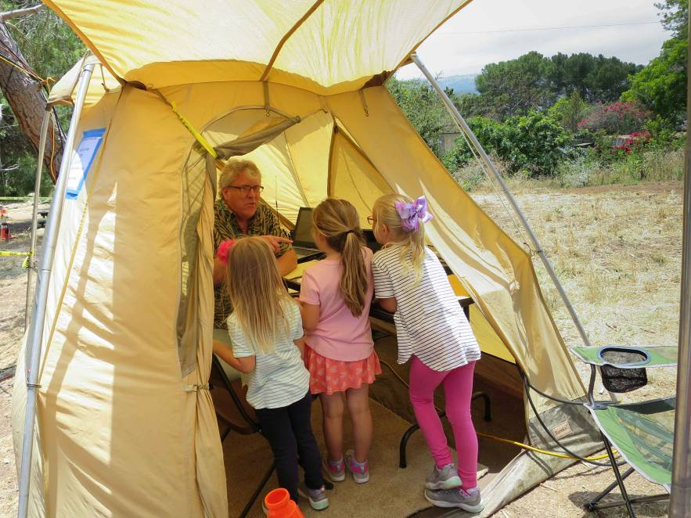
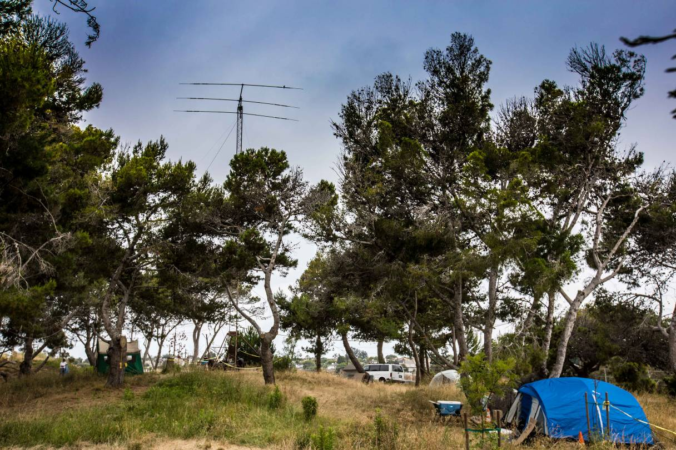
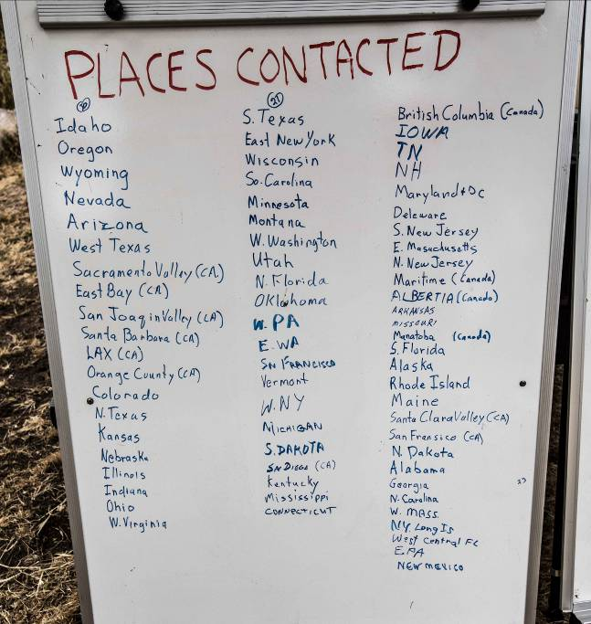
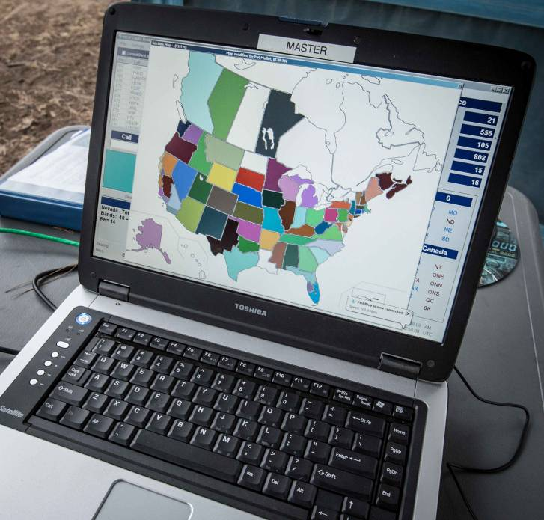
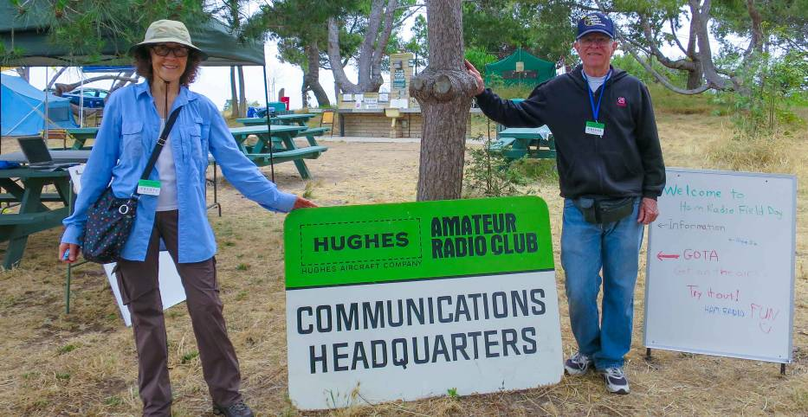
W6HA Field Day 2020 Results
December 15, 2020
Not at Wilderness park this year
Distributed from homes and mountains
We did Well!!
More points, CW, and digital
Similar phone QSOs

Slide 2
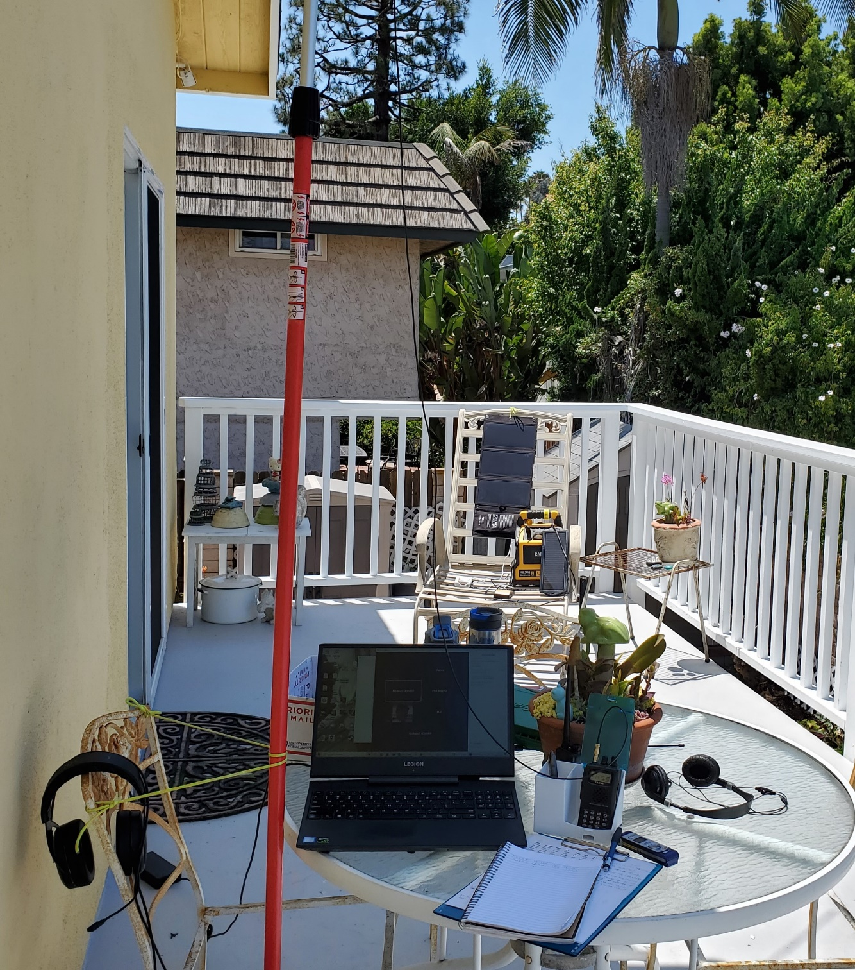
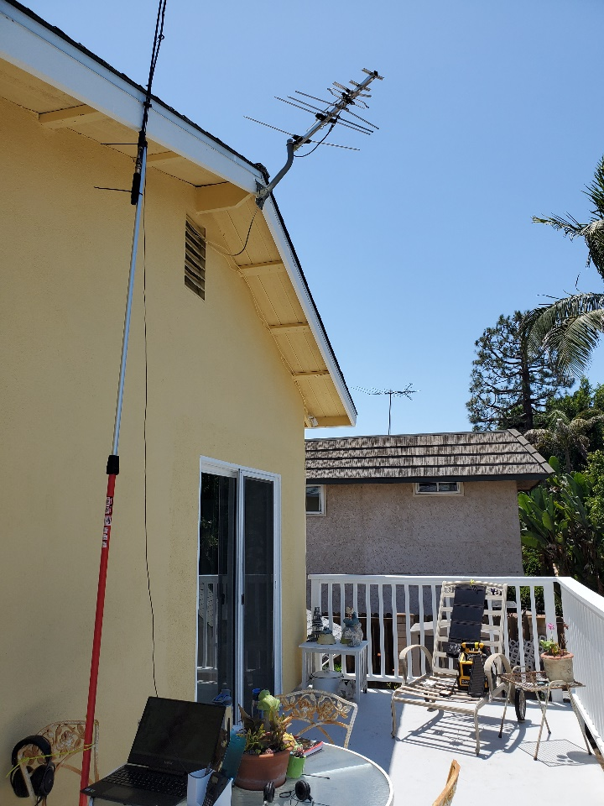
Manhattan Beach – New Ham first field day

Slide 3
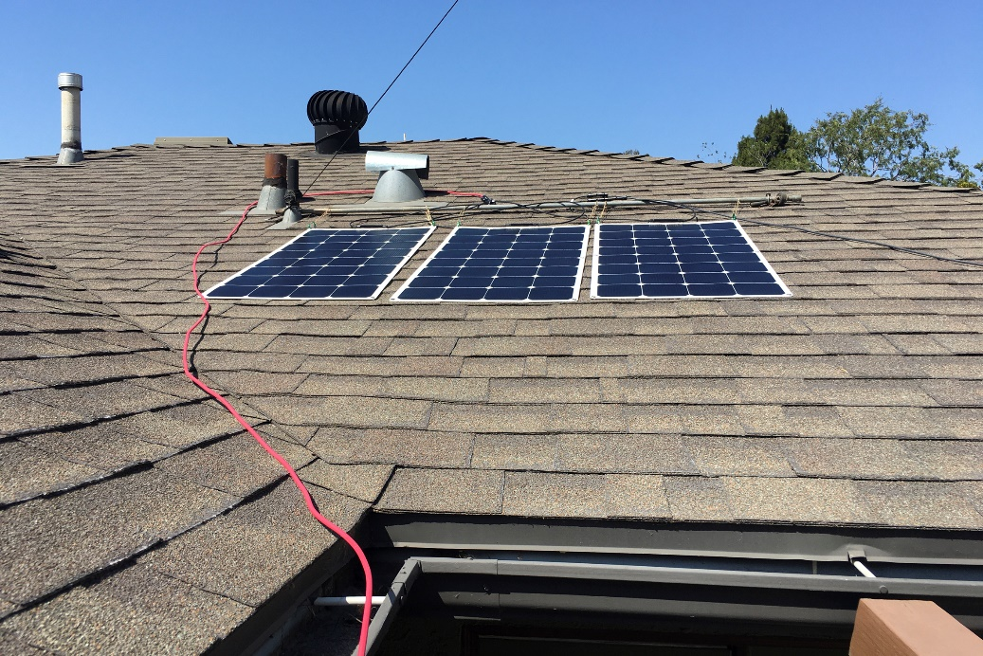
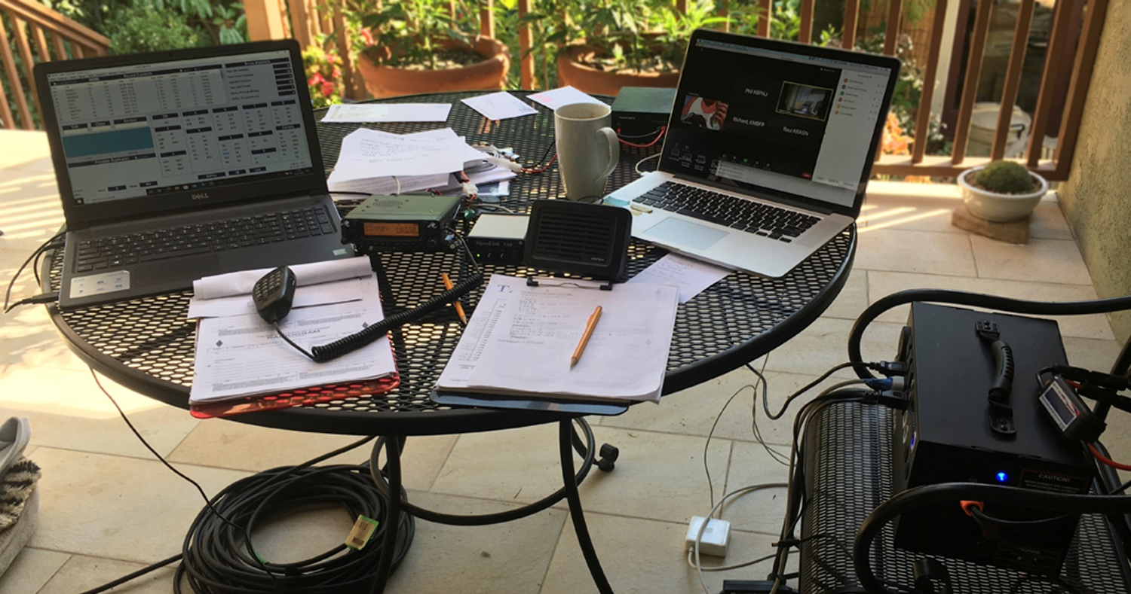
Palms – First Solo Field Day
Plus virtual field day via zoom, kept the club members together

Slide 4
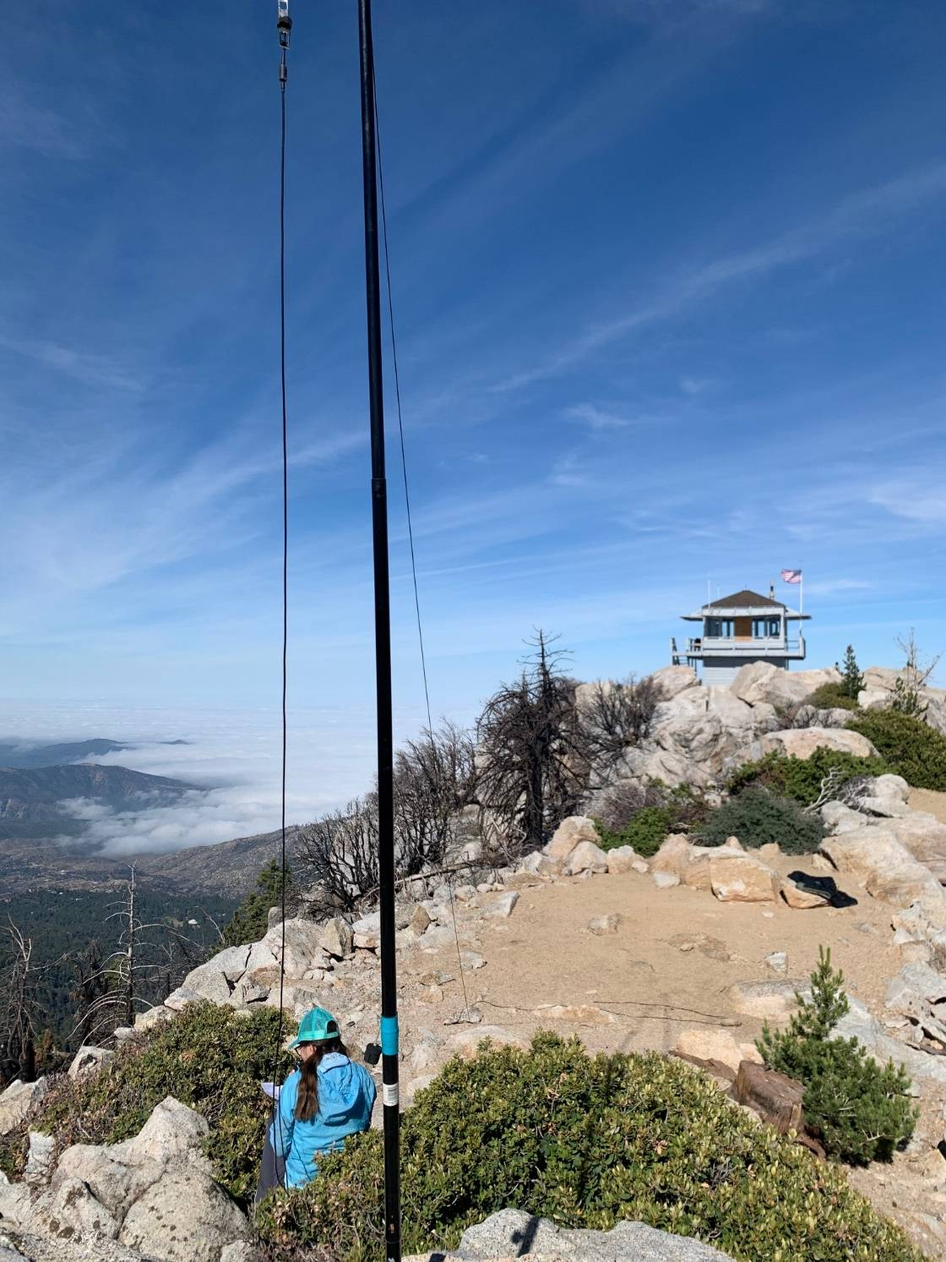
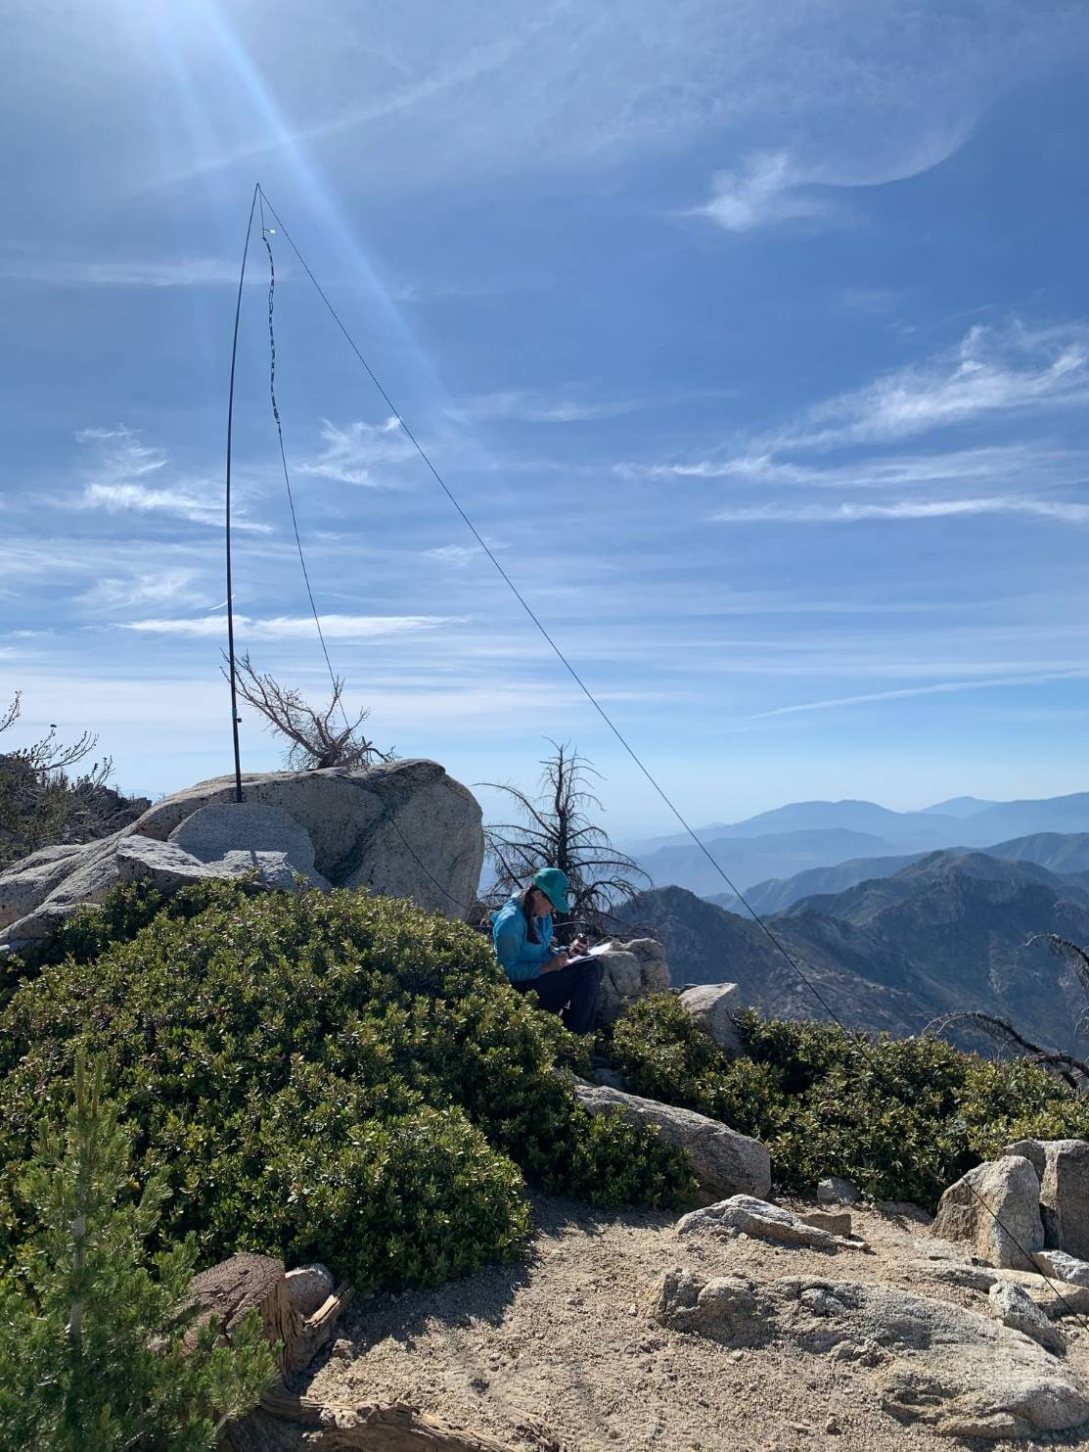
Tahquitz Peak San Jacinto Mountains 2 New Hams first field day

Slide 5
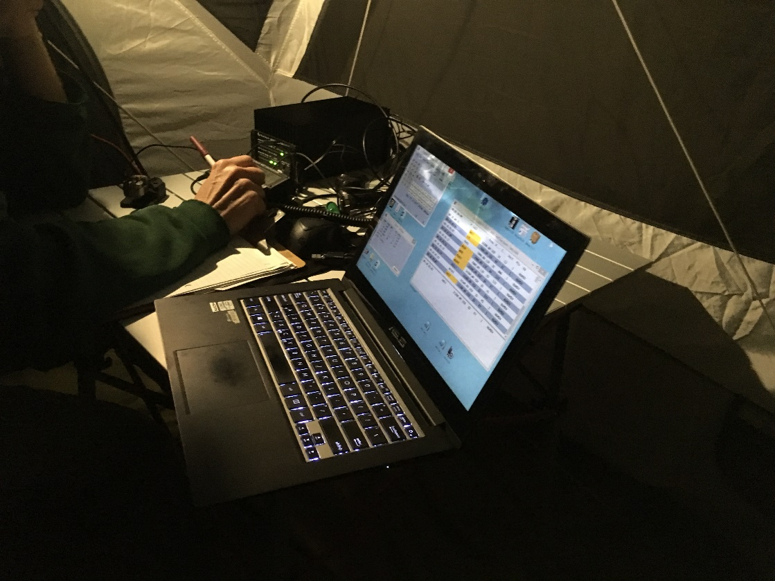
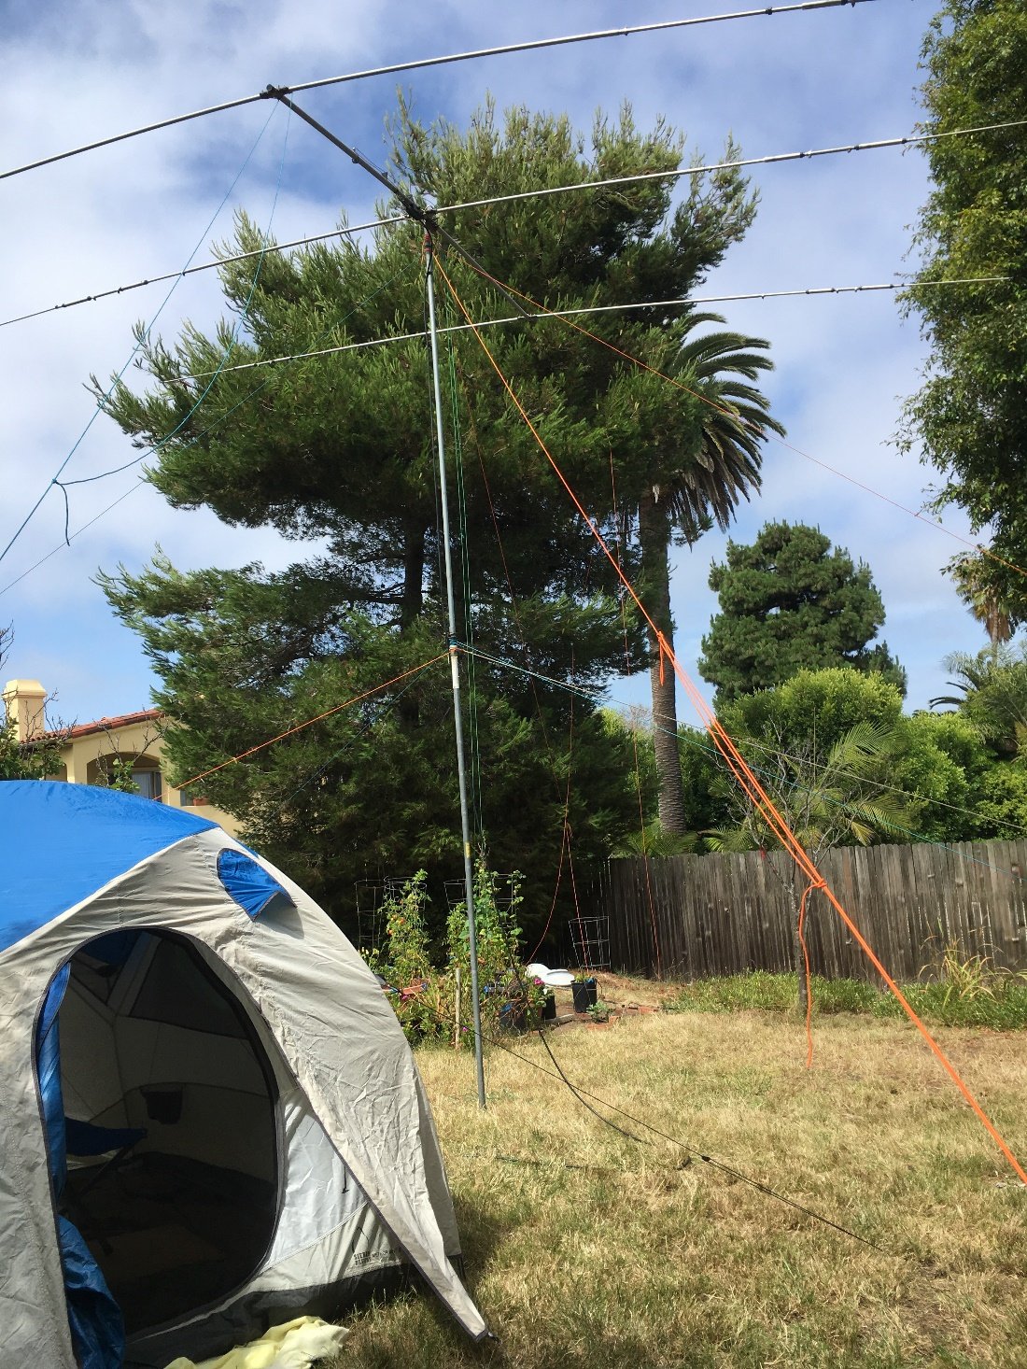
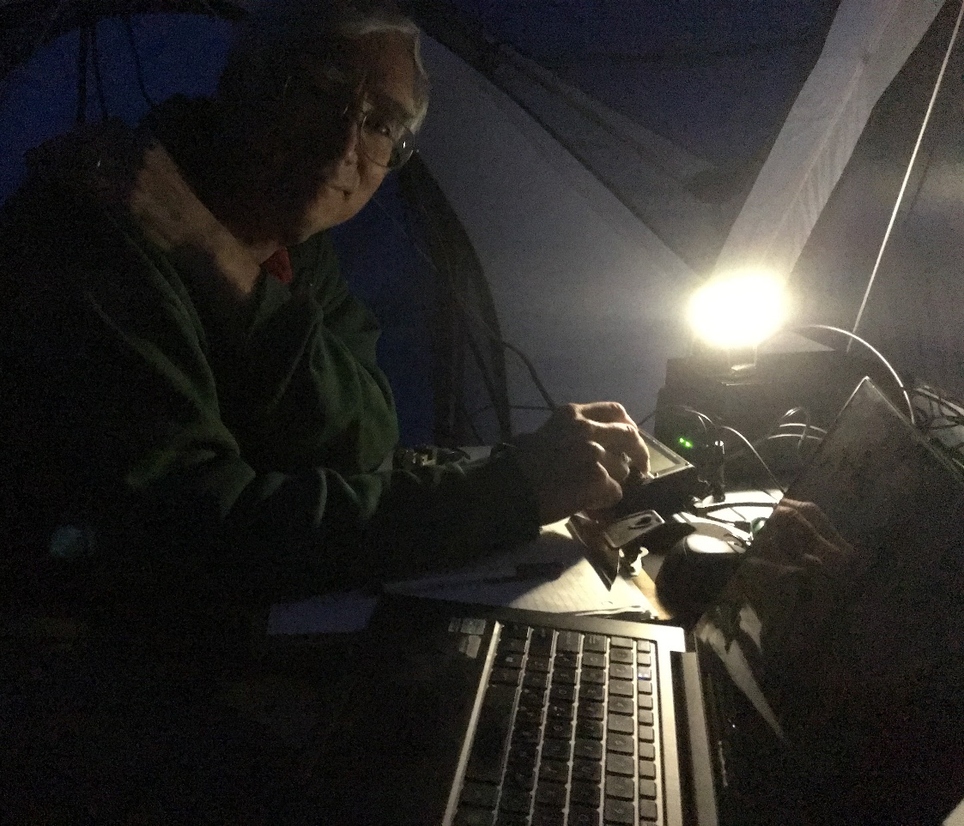
Manhattan Beach 2 Hams some club gear

Slide 6
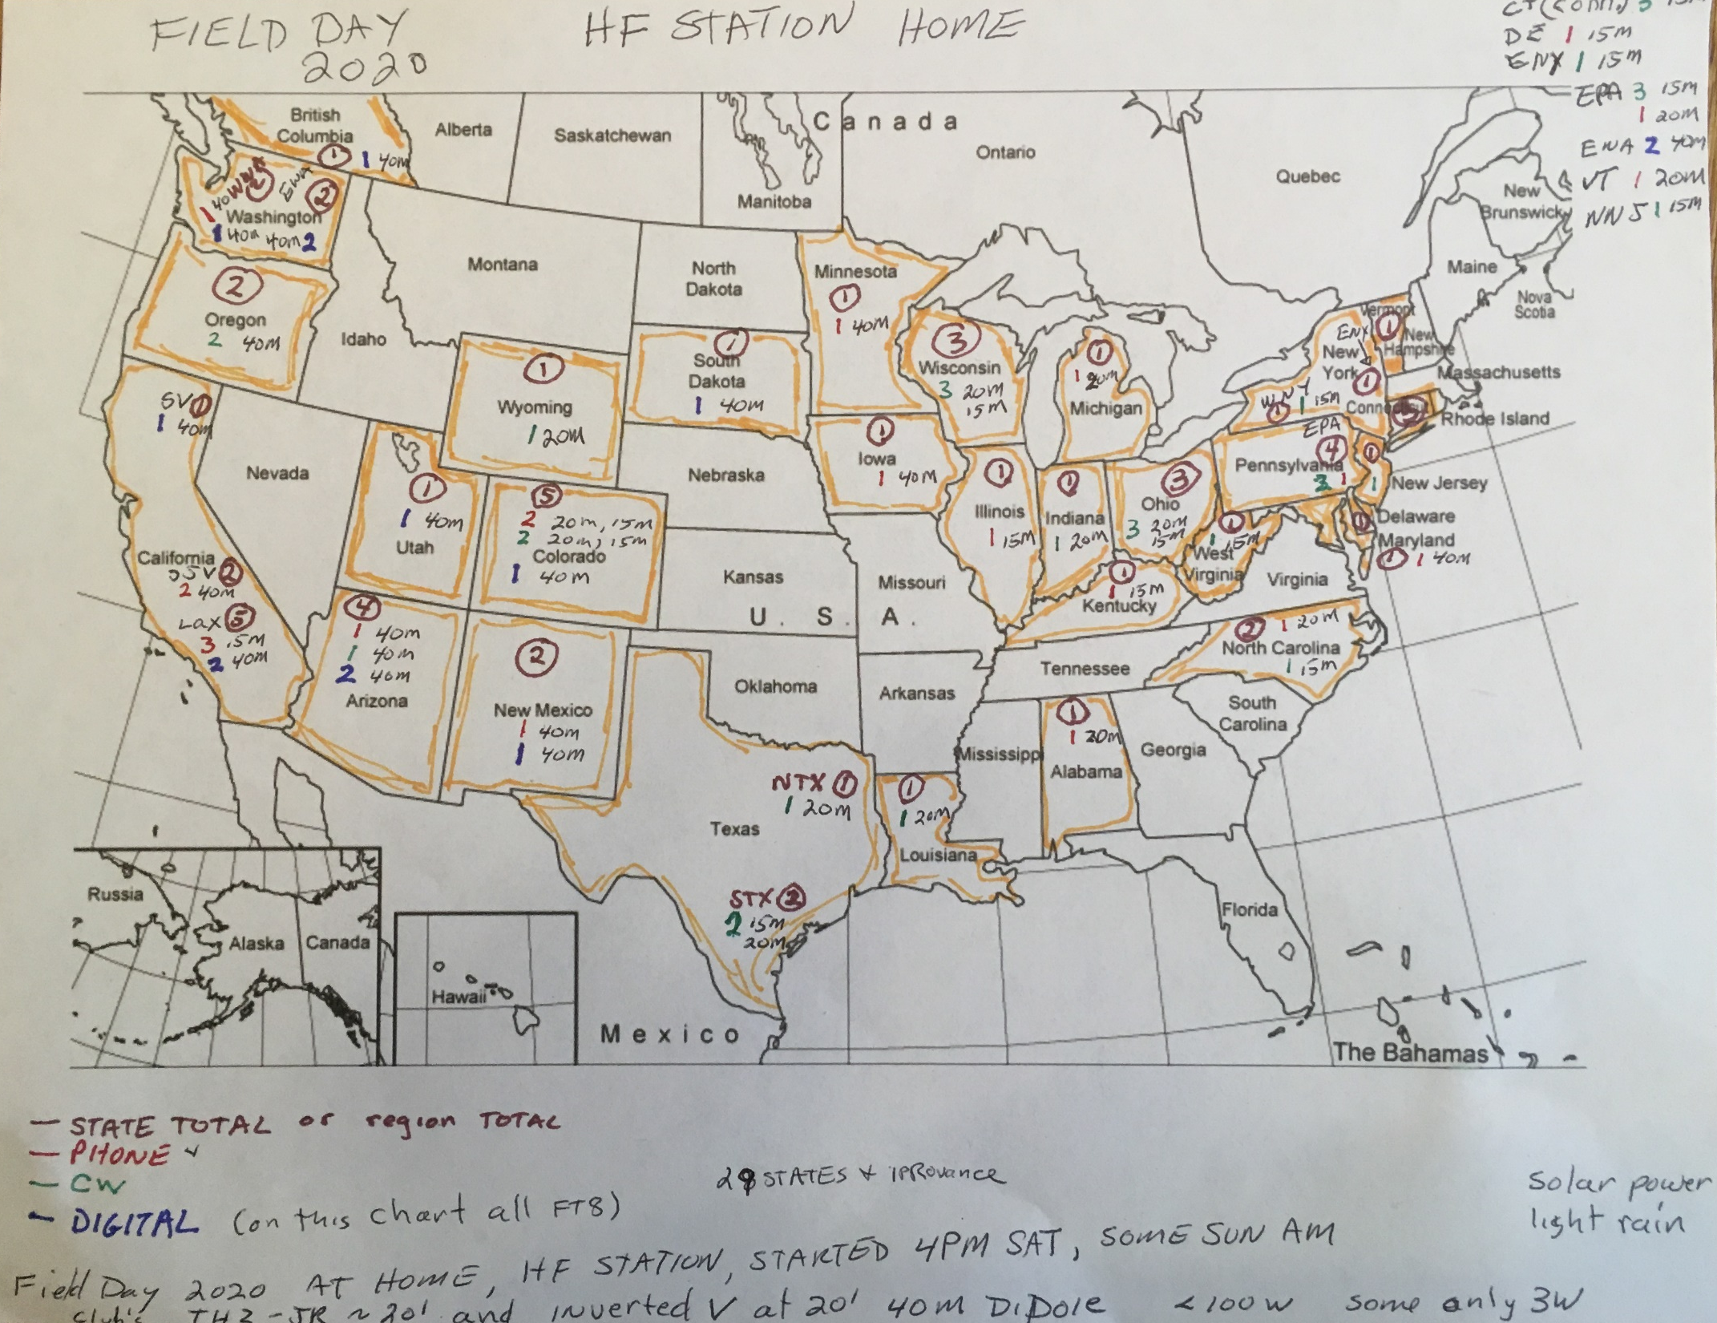

Slide 7
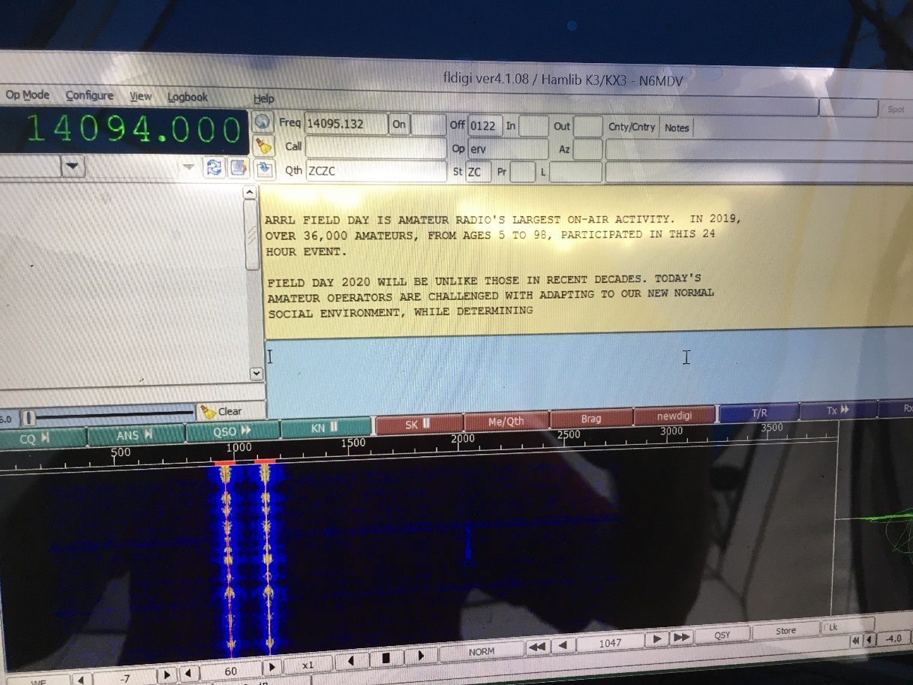
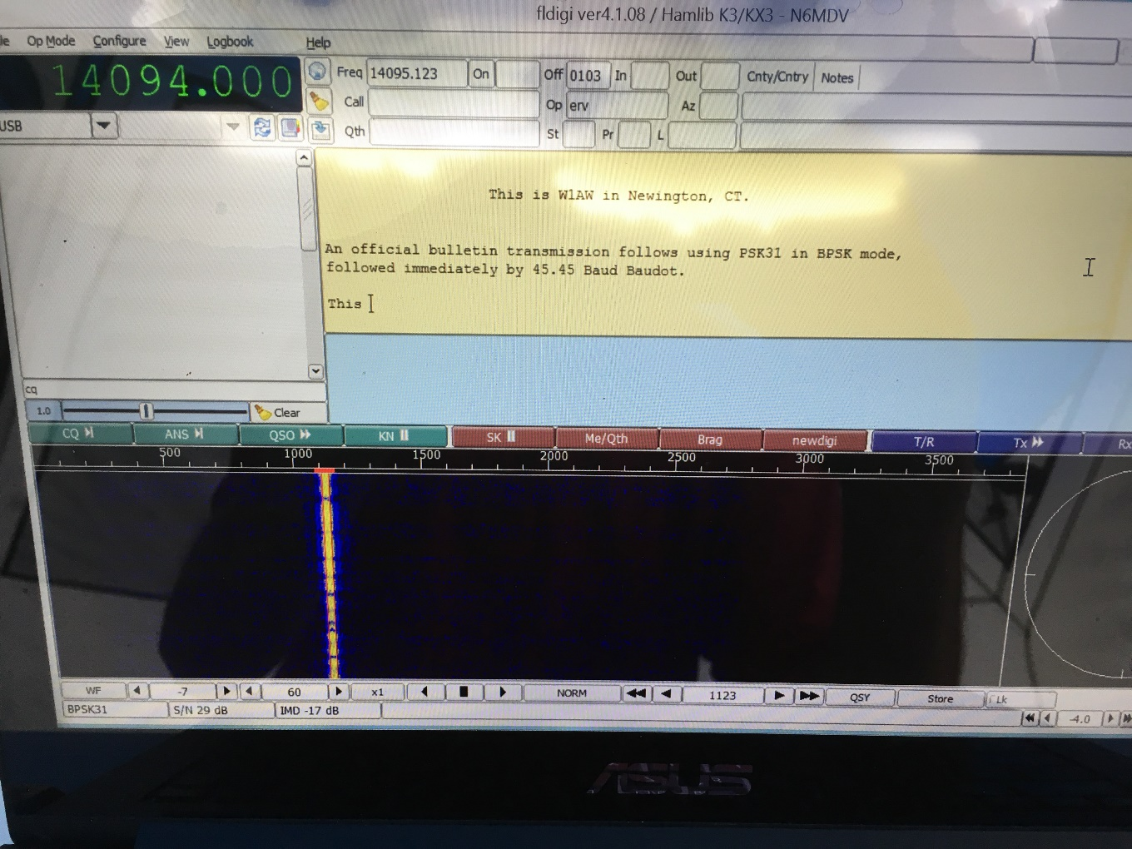
Bulletin PSK RTTY

Slide 8
Field Day Bulletin 2020
PSK 31 version
ZCZC AX10
QST de W1AW
Special Bulletin 10 ARLX010
From ARRL Headquarters
Newington CT June 26, 2020
To all radio amateurs
SB SPCL ARL ARLX010
ARLX010 E020 W1AW Field Day Bulletin
os
ARRL Field Day is amateur radio's largest on-air activity. In 2019,
over 36,000 amateurs, from ages 5 to 98, participated in this 24
hour event.
Field Day 2020 will be unlike those in recent decades. Today's
amateur opetators are challenged with adapting to our new normal
social environment, while determining how to carry out support
communications to assist served agencies and the public.
This year
has in part been an ongoing emergency preparedness exercise.
While this year may not be the social gathering or public
demonstration opportunity of past years, this year is an opportunity
to determine how to participate from home, or how to operate
remotely while still interacting with your group or club.
This year has also seen a significant increase in the use of social
media discussing how we are adjusting our communications resources
and tools to remain effective and able to serve others. Be sure to
promote your Field Day and use #ARRLFD.
This year will be the year for you to expand you horizons and try
something different. Experiment, adapt, and be creative. By doing
so, we can push the boundaries of amateur radio to new heights. Be
sure to check December QST for the 2020 Field Day results article.
Good luck and 73.
NNNN

Slide 9
Winlink NTS Messages
Message ID: 4RA0EBX5RL0L
Date: 2020/06/27 16:33
From: N6MDV
To: vhpilot40@gmail.com
Cc: president@w6ha.com
Source: N6MDV
Subject: FIELD DAY RADIOGRAM
4 R N6MDV 20 MANHATTAN BEACH CA JUN 27
JAMES COLE
APPLE VALLEY CA
VHPILOT40 ATSIGN GMAIL DOT COM
BT
JAMES CONGRATULATIONS ON YOUR NEW
RADIO LICENSE X HAVE FUN
AND ENJOY THE HOBBY FROM
HUGHES AMATEUR RADIO CLUB 73
BT
MIKE VAHEY N6MDV

Slide 10
W6HA Field Day 2020 How Many Points?
QSO Points
25 CW +133 Digital +558 Phone = 716 QSOs
2019: 21 CW +122 Digital + 726 Phone = 869 QSOs
2018: 10 CW +22 Digital + 1386 Phone = 1418 QSOs
Power Multiplier and Point multiplier: 2228 QSO Points
2019 Power Multiplier and Point multiplier: 2024 QSO Points
Bonus Points: 4010
2019 Bonus Points: 1670
We have points in many bonus categories!
Solar, emergency power, newspaper, W1AW bulletin
10 NTS messages, message to section manager
Total Field Day Points = 6238
2019: Total Field Day Points = 3694
2018: Total Field Day Points = 4606

Slide 11
Quick Comparison
LAX Section had 228 logs
We provided 11 of them plus 2 from ORG
Nation wide
10,213 logs
1,862,985 QSOs
18,886 participants

Slide 12
W6HA Participation 14+ club members
CALL | Operator | SCORE | Category | Section | Pwr- Mult | Participants | Xmtrs | Power | CW | DIGITAL | PHONE | TOTAL QSOs | BONUS POINTS
K6ASN | Raul | 554 | 1E | LAX | 2 | 2 | 1 | G | 0 | 70 | 12 | 82 | 250
K6LDQ | John | 564 | 1E | LAX | 2 | 1 | 1 | B | 0 | 2 | 133 | 135 | 290
K6PNJ | Phil | 600 | 1E | LAX | 2 | 1 | 1 | B | 0 | 0 | 75 | 75 | 450
K6VHY | Karen | 1,050 | 1E | LAX | 5 | 2 | 1 | B | 0 | 0 | 80 | 80 | 650
KM6FP | Richard | 164 | 1D | LAX | 2 | 1 | 1 | C | 0 | 0 | 57 | 57 | 50
KN6HVH | Suzanne | 70 | 1B2B | ORG | 5 | 2 | 1 | B | 0 | 0 | 4 | 4 | 50
AJ6N/KN6ISU | Vance | 415 | 1B1B | LAX | 5 | 1 | 1 | B | 0 | 0 | 31 | 31 | 260
KV6R | Tim | 470 | 1B2B | ORG | 5 | 2 | 1 | B | 0 | 0 | 42 | 42 | 260
N6MDV | Mike | 852 | 1B2 | LAX | 2 | 2 | 1 | B | 25 | 15 | 21 | 61 | 650
NY6Y | Gary | 234 | 1D | LAX | 2 | 1 | 1 | C | 0 | 46 | 0 | 46 | 50
W1MII | Dick | 694 | 2A | LAX | 2 | 3 | 2 | G | 0 | 0 | 22 | 22 | 650
WA6SET | Tom | 165 | 1B1B | LAX | 5 | 1 | 1 | B | 0 | 0 | 3 | 3 | 150
WB6MMQ | Dale | 406 | 1E | LAX | 2 | 1 | 1 | G | 0 | 0 | 78 | 78 | 250
TOTAL |  | 6238 |  |  |  | 20 |  |  | 25 | 133 | 558 | 716 | 4010
W1MII included N6VZF and other family members

