Slide 1
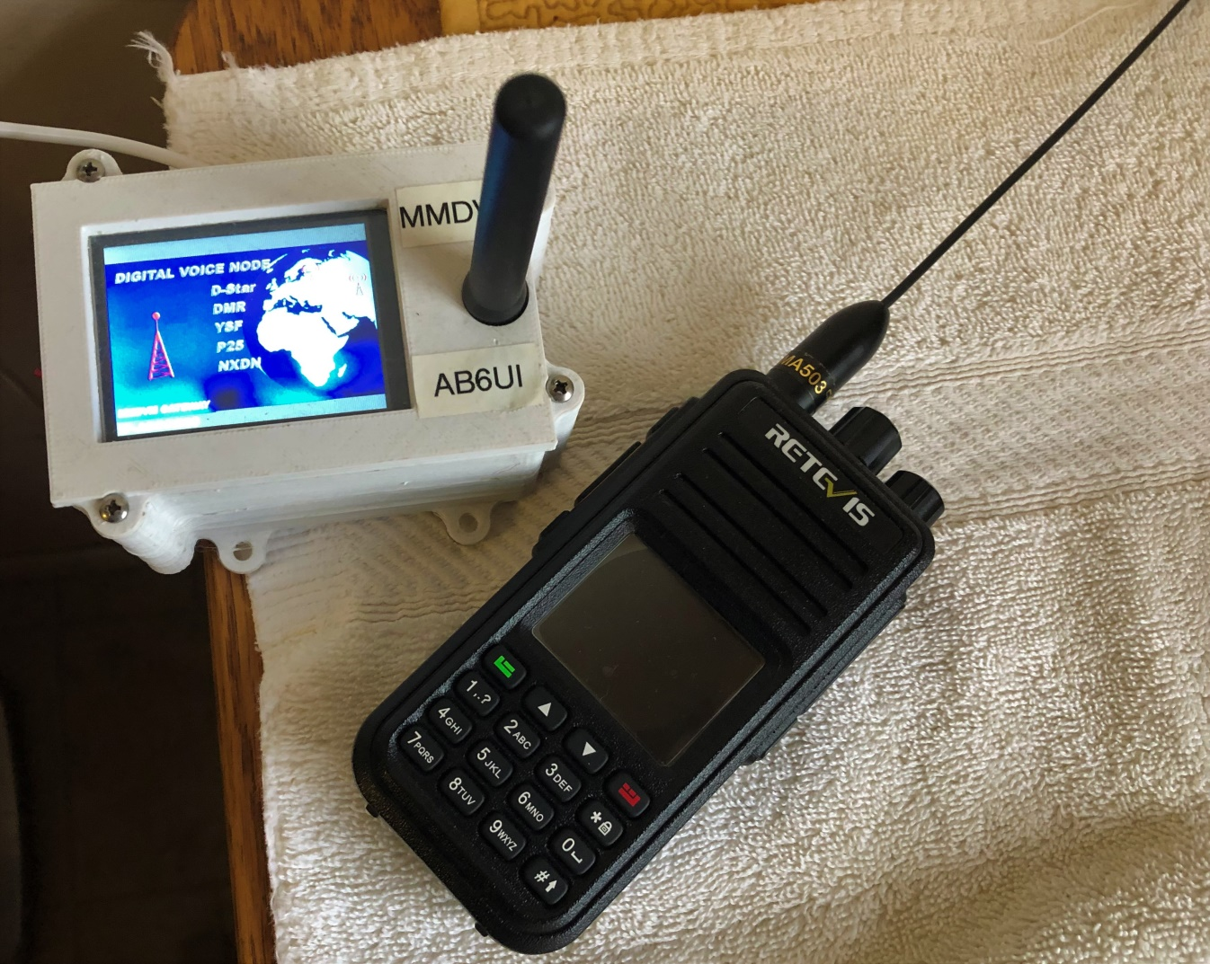
A Beginners guide to Digital Radio Hot Spots
W6HA ARC
By: Brian Johnson, AB6UI Oct 2020

Slide 2
Why Digital
It seems that the world is going digital. Television broadcasters stopped analog broadcast in 2009 and now TV is digital. We even have several digital broadcast radio services available… So It might seem like HAM radio is falling behind but nothing could be farther from the truth!
All the major Ham Radio manufactures have come out with “digital” radios. (as well as several lesser known brands)
Several advantages of using digital voice modes are that it uses less bandwidth than analog voice modes such as amplitude modulation and frequency modulation.
The quality of the data received is also better than an analog signal at the same signal strength, as long as the signal is above a minimum threshold and as long as there is no multipath propagation.
Compatible radios are available for HF, VHF, UHF, and microwave amateur radio bands. In addition to the over-the-air protocol, digital radio also provides specifications for network connectivity, enabling radios to be connected to the Internet or other networks, allowing streams of voice or data to be routed via the internet, across the state, across the country, and even around the world!
But there is a catch… There is no standard!

Slide 3
Digital Voice “Standards”?
Here is a summary of the three major amateur radio digital voice standards:
DMR:
DMR stands for Digital Mobile Radio and it was a digital voice standard developed by Motorola (AKA MOTOTRBO™) for mobile radio systems, especially those used for commercial applications. In view of its original applications, it has many features that are aimed at commercial / business users. The mode has become popular within the amateur radio community due to the relative lower cost and complexity compared to other commercial digital modes.
D-Star:
D-Star digital voice standard was developed by the Japan Amateur Radio League, JARL in conjunction with a number of universities and amateur radio companies. D-Star is an open standard, although it does use an AMBE codec which is proprietary and it is not possible for radio amateurs to obtain licenses for the code development. The first D-Star is found in ICOM and Kenwood radios.
YAESU System Fusion:
Although properly called C4FM, it is often referred to simple by the name YSF. It is a digital voice system for amateur radio designed by Yaesu and as such it is not an open standard. Yaesu is the only manufacturer of radios for this mode.
There are also TETRA, P25 and NXDN although they are less common
There is really NO standard

Slide 4
Getting started in Digital Radio
There are many factors when it comes to selecting your first radio. A fundamental issue is that the hardware must be “flashed” with a “code plug”. So it is critical that the hardware you obtain makes this process as easy as possible.
The PAPA System has placed 15 DMR repeaters on the air in Southern California and networked them with other California DMR repeaters, as well as those around the world. In order to get hams on the air easily, PAPA codeplugs are available for Anytone, Connect Systems, Hytera, Motorola, Radioddity, TERA and TYT radios.
So now what radio??? Alter listening to DMR for sometime I have concluded that the TYT MD-380 is the most common DMR radio out there and as such there is a lot of help available to you. (not only that they are one of the most reasonably priced!)
Now that you have ordered a DMR radio you will need a Radio ID (Subscriber ID):
DMR is digital, and networked, so each radio has a unique ID number to identify it on the network. To obtain a DMR radio ID, go to: https://www.radioid.net/register#!
Several club members are knowledgeable in DMR

Slide 5
The Beginners Guide To Hotspots
A hotspot, simply put, is your internet gateway to a particular DMR network. You would use a hotspot when you either don’t have a DMR repeater nearby, you simply don’t want to tie it up for any length of time or you want to go mobile.
Many hotspots are capable of multiple modes as well, such as D-Star, P25, DMR+, YSF and NXDN… but we are only going to talk about DMR & YSF today.
You will need a wireless internet connection “Wi-Fi”

Slide 6
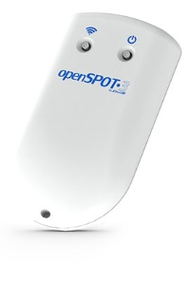
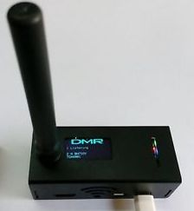
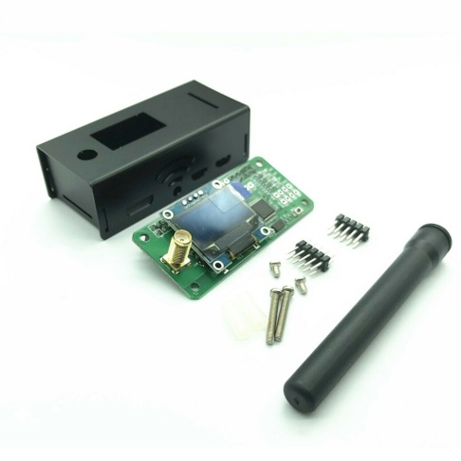
Your 1st Hotspot
There are several commercially available hotspots on the market today probably one of the most popular is the “SharkRF Open Spot 3” it is only available directly from the vendor in Estonia and costs about $315 out the door.
Another option is the MMDVM hotspot. You can get one (from Amazon) for about $120 complete with R-Pi Zero & case.
But being the DYI kind of guy I am I went for the kit version from eBay for about $38. It comes with everything you need except the R-Pi Zero. I already had a few I picked up from MicroCenter (for $5) so my total cost was under $50
All do about the same but you will learn more by going the DIY Route!

Slide 7
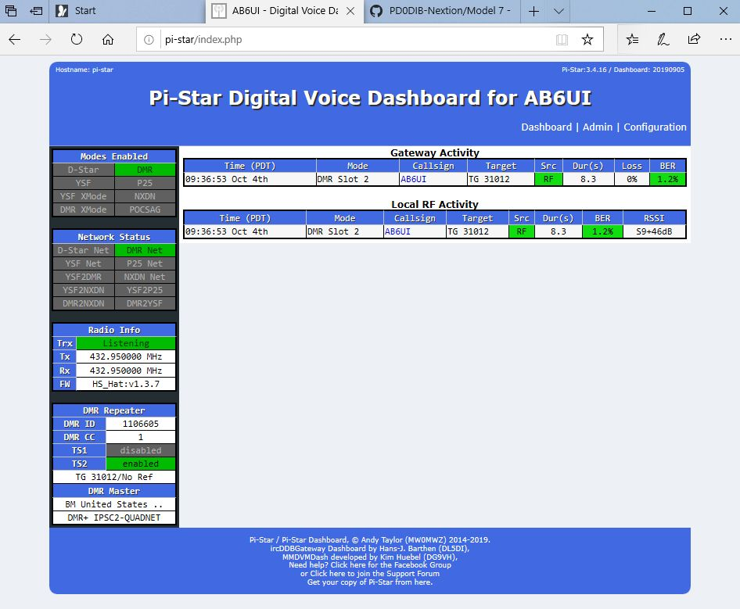
Setting up your MMDVM hotspot is beyond the scope of this presentation but
There are several great YouTube videos to get you going.
This one is very good. https://www.youtube.com/watch?v=DDZMY_6qjjI
Once you get your MMDVM HotSpot running Pi-Star you will see something like this…
Now you are only limited by the code plug in your DMR radio

Slide 8
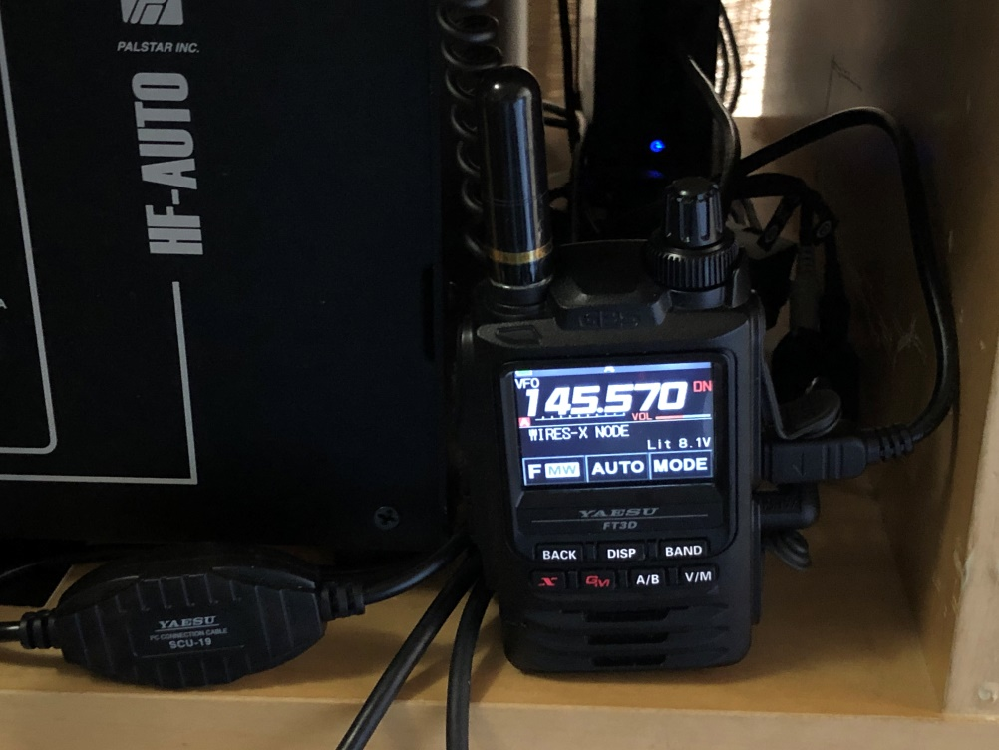
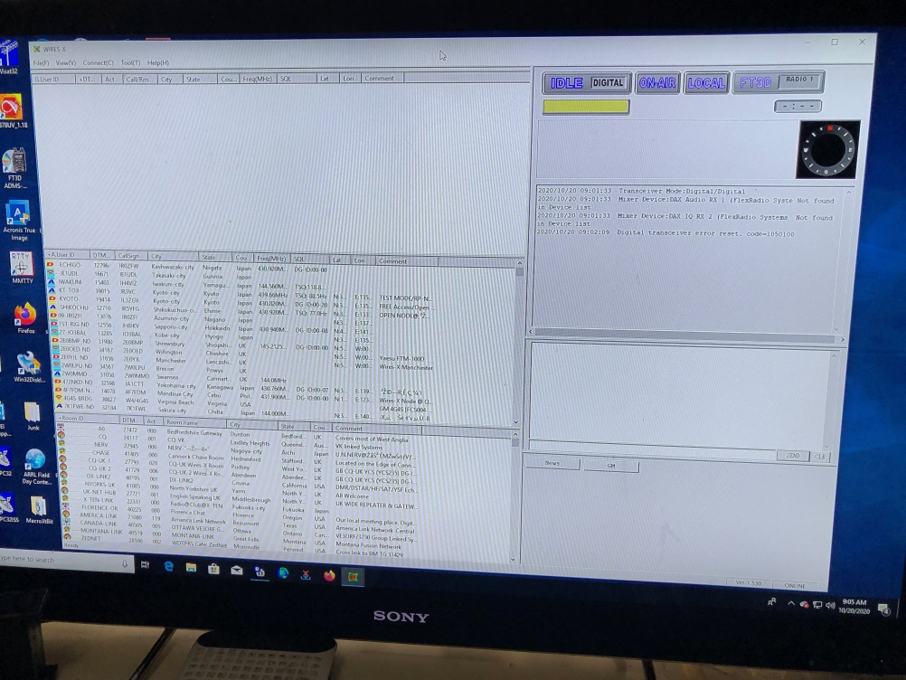
Do you really need a HotSpot?
With several Yaesu YSF radios the answer is NO!
There is a feature called Portable Data Node “PDN” available in several Yaesu mobile and handheld radios
The FTM-100DR, FTM-300DR, FTM-400DR and FTM-400XDR mobile radios as well as the FT-2DR and FT-3DR handheld radios All have the required Software. But you will need some additional hardware…
Namely the SCU-39 Connection Kit (available from HRO for $59.99) It includes the SCU-19 and the appropriate audio cables and connectors you need to get everything hooked up.
There are DIY options available

Slide 9
Taking it on the Road
As I mentioned before all you need is a connection to the internet to connect.
Wi-Fi is available at all sorts of places some free some not so much…
Mc Donald's, Starbucks all have free Wi-Fi (as well a many other places)
Many cell phones can create a Wi-Fi connection (extra fee)
Many new cars have Wi-Fi capability (extra fee)
So with your DMR hotspot or PDN you can get into your favorite room
from just about anywhere!
Unfortunatly Covid-19 Makes a demo impractcal

Slide 10
Questions?

