Slide 1
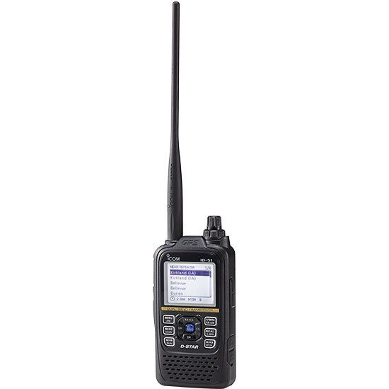
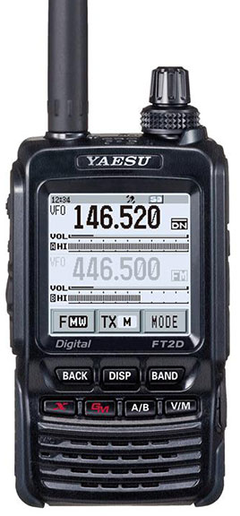
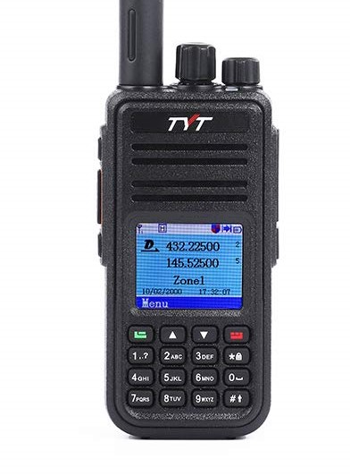
Digital Voice Modes
W6HA ARC
By: Brian Johnson, AB6UI August 2019

Slide 2
Why Digital
It seems that the world is going digital. Television broadcasters stopped analog broadcast in 2009 and now TV is digital. We even have several digital broadcast radio services available… So It might seem like HAM radio is falling behind but nothing could be farther from the truth!
All the major Ham Radio manufactures have come out with “digital” radios. (as well as several lesser known brands)
Several advantages of using digital voice modes are that it uses less bandwidth than analog voice modes such as amplitude modulation and frequency modulation.
The quality of the data received is also better than an analog signal at the same signal strength, as long as the signal is above a minimum threshold and as long as there is no multipath propagation.
Compatible radios are available for HF, VHF, UHF, and microwave amateur radio bands. In addition to the over-the-air protocol, digital radio also provides specifications for network connectivity, enabling radios to be connected to the Internet or other networks, allowing streams of voice or data to be routed via the internet, across the state, across the country, and even around the world!
But there is a catch… There is no standard!

Slide 3
Digital Voice “Standards”?
Here is a summary of the three major amateur radio digital voice standards:
DMR:
DMR stands for Digital Mobile Radio and it was a digital voice standard developed by Motorola (AKA MOTOTRBO™) for mobile radio systems, especially those used for commercial applications. In view of its original applications, it has many features that are aimed at commercial / business users. The mode has become popular within the amateur radio community due to the relative lower cost and complexity compared to other commercial digital modes.
D-Star:
D-Star digital voice standard was developed by the Japan Amateur Radio League, JARL in conjunction with a number of universities and amateur radio companies. D-Star is an open standard, although it does use an AMBE codec which is proprietary and it is not possible for radio amateurs to obtain licenses for the code development. The first D-Star is found in ICOM and Kenwood radios.
YAESU System Fusion:
Although properly called C4FM, it is often referred to simple by the name YSF. It is a digital voice system for amateur radio designed by Yaesu and as such it is not an open standard. Yaesu is the only manufacturer of radios for this mode.
There are also TETRA, P25 and NXDN although they are less common
There is really NO standard

Slide 4
Getting started in Digital Radio
There are many factors when it comes to selecting your first radio. A fundamental issue is that the hardware must be “flashed” with a “code plug”. So it is critical that the hardware you obtain makes this process as easy as possible.
The PAPA System has placed 15 DMR repeaters on the air in Southern California and networked them with other California DMR repeaters, as well as those around the world. In order to get hams on the air easily, PAPA codeplugs are available for Anytone, Connect Systems, Hytera, Motorola, Radioddity, TERA and TYT radios.
So now what radio??? Alter listening to DMR for sometime I have concluded that the TYT MD-380 is the most common DMR radio out there and as such there is a lot of help available to you. (not only that they are one of the most reasonably priced!)
Now that you have ordered a DMR radio you will need a Radio ID (Subscriber ID):
DMR is digital, and networked, so each radio has a unique ID number to identify it on the network. To obtain a DMR radio ID, go to: https://www.radioid.net/register#!
Several club members are knowledgeable in DMR

Slide 5
Other concerns
To put things simply, there are several "Big Ideas" with DMR: Color Code, Timeslot, Talkgroup and Zones: Color Code: This is the DMR version of PL.
Timeslot: DMR uses magic known as "Time Division Multiple Access" (TDMA). In Simple Ham English, this means the repeater can support two simultaneous conversations by alternating between two timeslots. About 30ms is given to timeslot 1, then the transmitter flips to timeslot 2 for 30ms, then back to timeslot 1, and then to timeslot 2; you get the idea. Something like the mom who speaks to her 2 kids, allotting each of them 30ms to talk. Since you transmit on just one timeslot, your radio's battery last longer as it is really only transmitting about half the time you have the PTT keyed. In other words, the repeater's Time is Divided such that Multiple hams can have Access (TDMA).
Talkgroups: DMR is designed for the commercial market where radio users typically have something in common, such as Security, Engineering, Parade Operations, etc. It isn't very efficient to have separate repeater pairs for each group, so DMR uses "Talkgroups" to group together users who want to talk to each other. On our DMR repeaters we have several Talkgroups that allow you to talk to geographically increasing areas: local, regional, statewide, all the way up to worldwide. Talkgroups are also either "Always On" (Static for BrandMeister) or "User Activated" (Dynamic for BrandMeister). "Static" or "Always On" means just that, network traffic to this talkgroup is always on. "Dynamic" or "User Activated" talkgroups have a timer associated with them, typically 10 minutes. The practical side of this is that after 10 minutes of local inactivity on a User Activated talkgroup, it is dropped from the network connection. To start listening to a User Activated talkgroup, key up, and you probably want to talk at least once every 10 minutes as well in order to keep the network feed.
Zones: Think of a "Zone" as a way to organize a group of channels. For most folks there are several talkgroups they wish to use, and several repeaters as well. Multiply that number of talkgroups by the number of DMR repeaters you want to use and this can make for a lot of channels. How can we keep things organized? We use Zones to give us a convenient way to organize these talkgroups. Again, remember that DMR is a commercial thing. We group our channels into Zones for ease of use, such as putting all the Parade Ops talkgroups into one Zone. It is easier to select a channel within a Zone than it is to scroll through hundreds of channels to find the right combination of repeater and talkgroup. You can set up your Zones pretty much however you like, be it a Zone for each repeater or a "Road Zone" containing the talkgroups on the different repeaters you use on your roadtrip. Zones can contain DMR and analog repeaters as well. Set them up so they work for you.
Although this may sound like a daunting task with a little reading and some help from an Elmer it is a lot of fun!

Slide 6
What is BrandMeister?
BrandMaster/BrandMeister is an operating software for Master servers participating in a worldwide infrastructure network of amateur radio digital voice systems.
If you are an amateur radio operator working in digital voice modes like D-Star, DMR, C4FM, APCO P25 or others (not all are supported yet!!). You do not need to know much about BrandMeister, and it's very easy to operate on its infrastructure.
If you are an amateur radio operator that runs a repeater in your local area, you may be interested in learning some more about BrandMeister and how you can take part in it.
A brief overview of BrandMeister core features:
Switching system for IP-enabled conventional Tier-2 DMR radio
Supports the most known network-access and end-user equipment making it easily expandable
Performs switching on the Layer 3 (Call Control) of the DMR stack
Has an embedded data stack (Layer 4)
Has embedded data and voice applications
Flexible routing based on data stored in a global database, local memory cache, and Lua scripts
Event notification using messaging queues (calls, connections, alarms, messages, locations and telemetry)
Implements mesh-topology for inter-node communications
BrandMeister allows you to connect to MOTOROLA DMR-MARC and Hytera DMRplus networks, this means you can operate with other DMR amateur radio operators on both infrastructures the same time.
BrandMeister allows me…
To roam automatically from repeater to repeater
To make private QSOs on any time-slot
To make world-wide QSOs with any type of amateur DMR network
To send my location to APRS
To send and receive SMS messages
To send and receive SMS messages to or from APRS
To control some electric thing using my DMR radio as a remote control device
Several club members are knowledgeable in AREDN

Slide 7
Flashing
It is important that you are comfortable programming a radio using a computer.
Your radio must be “flashed” with a “code plug”.
For first time users the PAPA DMR code plug is highly recommended.
You can create your own code plug and its really not that hard but it beyond the scope of this presentation. I have included some screen shots from what you need to do if you decide to design your own code plug in the appendix…
See Appendix for some examples

Slide 8
Demo Time
DMR HotSpots can be used anywhere there is an interconnection

Slide 9
Web links
Web pages
Brandmeister network
papa system
Retevis RT3S Dual Band DMR Radio Programming Guide
Questions?

Slide 10
Appendix

Slide 11
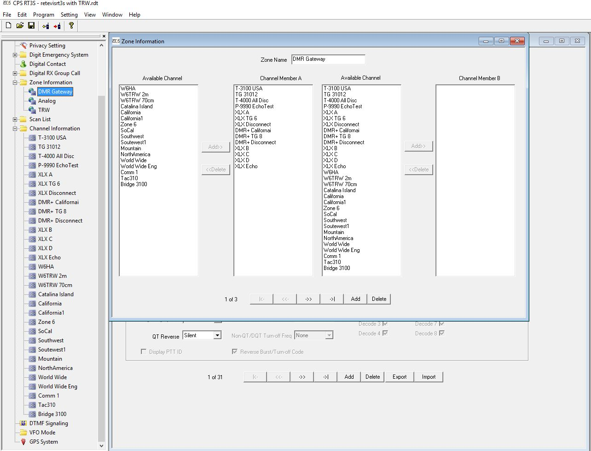
Appendix (cont)

Slide 12
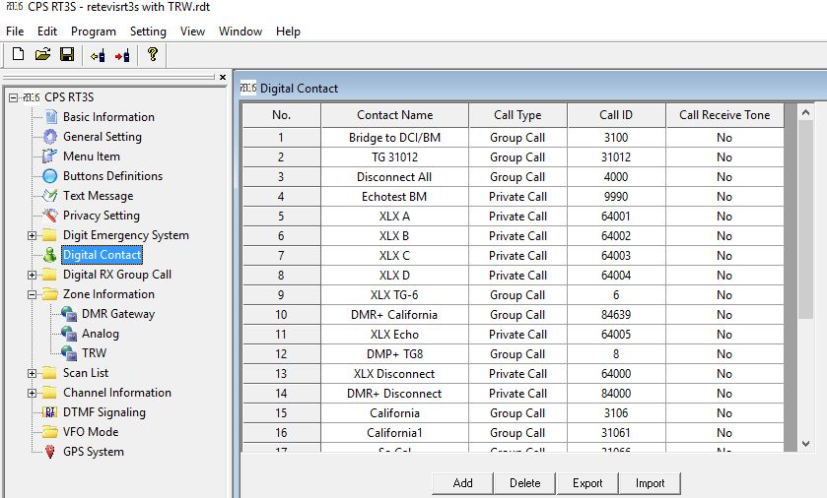
Appendix (cont)

Slide 13
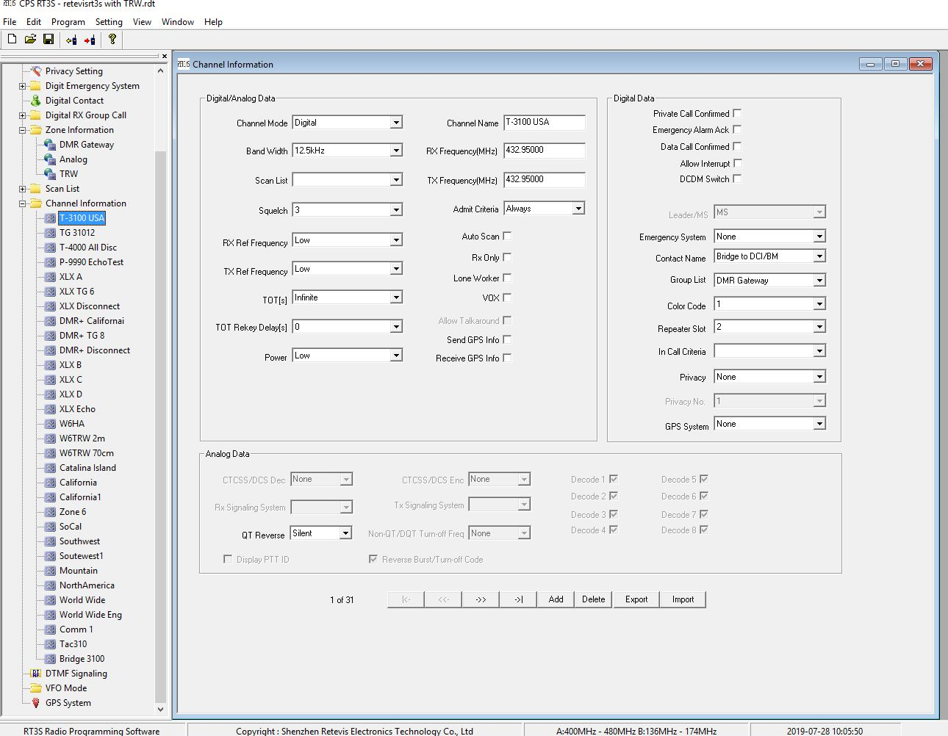
Appendix (cont)

