Slide 1
New Digital Mode FT8
See & Work Signals below the Noise Floor !
Plus Work DX remotely from any place now with WSJT-X Digital Modes
Live Demonstration
AB6UI
Brian Johnson

Slide 2
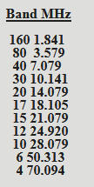
Digital Modes – JT-65 – JT9 – FT-8
New FT8 Digital Mode Specifications
- Why can we see below the Noise Floor ?
Resources : https://wsjtx.net/home/ft8-mode.html
Download Free Program : http://physics.princeton.edu/pulsar/K1JT/wsjtx.html
FT8 is designed for situations like multi-hop Es where signals may be weak and fading,
openings may be short, and you want fast completion of reliable, confirmable QSOs.
Important characteristics of FT8:
- T/R sequence length: 15 s
- Message length: 75 bits + 12-bit CRC
- FEC code: LDPC(174,87)
- Modulation: 8-FSK, keying rate = tone spacing = 5.86 Hz
- Waveform: Continuous phase, constant envelope
- Occupied bandwidth: 47 Hz
- Synchronization: three 7x7 Costas arrays (start, middle, end of Tx)
- Transmission duration: 79*2048/12000 = 13.48 s
- Decoding threshold: -20 dB (perhaps -24 dB with AP decoding, TBD)
- Operational behavior: similar to HF usage of JT9, JT65
- Multi-decoder: finds and decodes all FT8 signals in passband
- Auto-sequencing after manual start of QSO

Slide 3
Is Digital a FT8 Weak Signal or a Low Power Mode ?
That depends on many factors !
There is definitely a difference between a "weak signal" mode and a "low power" mode. Low power modes are designed to 1) save electricity, 2) reduce RFI, 3) be undetectable for covert operations, or 4) give hobbyists something to do in their excess spare time. (I jest...I love QRP ops, too.) But weak signal modes are designed to: 1) maintain communications when band conditions are poor, 2) enable communications via meteor scatter, moon bounce, or during times of wide and rapid signal facing. 3) enable communications at the extreme ends of the radio spectrum when power and/or antenna construction is technically difficult or expensive, 4) extend communications at the beginning and end of normal band openings when signal strengths are weak. There are additional comments that could or will be made, I am sure. I also add a third category to the mix -- Narrow bandwidth modes.....
These are modes that may be either low power or weak signal modes, but one of their attributes is also that they take up much less bandwidth than some other modes.... e.g. JT9 takes up about 10% of the bandwidth as JT65 or JTDX, without sacrificing much of the weak signal performance. Both of the modes take a long time to transmit, and have a limited message length - a trade-off for weak signal performance. PSK31 and its cousins are very narrow bandwidth, with unlimited transmission and message length. PSK31 used to be seen as a weak signal mode, until the JT's came along. But it is one of the best weaker signal modes for general conversation. MSK144 is a great weak-signal mode, but takes more bandwidth than either JT65 or JTDX. FT8 is a sort of compromise - 4-6 times faster than JT9/65, but still with limited message length. It is a little wider than JT9, but about 9 dB less sensitive than JT9/65 or JTDX. (-20 vs. -29 dB)

Slide 4
What You Need to Use WSJT-X FT8
In order to use WSJT-X, an amateur radio operator (ham), or a short wave listener (SWL),
needs the following:
A frequency stable radio and an antenna
(the frequency range for both depends on the band);
2. a sound card interface in order to pass the received audio to a computer;
3. a copy of WSJT-X, available http://physics.princeton.edu/pulsar/K1JT/wsjtx.html (for Microsoft Windows, Linux or Macintosh);
4. an accurate computer clock. ( Such as Dimension 4 free program for PC )
The antenna depends on the band you wish to use, as well as how you would like to use
WSJT-X. You may want to use 160 meters, which generally requires large wire antennas,
or the microwave bands with a dish to bounce signals off the moon. WSJT-X is popular on the
HF amateur bands, but is also used on VHF for EME, as well as meteor scatter, rain scatter,
airplane scatter, or even to bounce signals off the International Space Station.
Perhaps you will have a unique idea for its use.
Note that the program is designed for weak signals. Weak signals does not mean low power.
On 20 meters many hams use low power (10 watts or less), but for EME, some hams use
1500 watts of output. As with all other amateur communications, the idea is to use the least
amount of power necessary. If you can work the world with milliwatts, that's great. If it takes 1500 watts on 6 meters to have an EME QSO,
that is also fine.
Many computers using Microsoft Windows are not very time accurate. If your PC's clock is off by just 5 seconds and you are attempting to
make a QSO via meteor scatter using 15 second intervals, then you are missing one third of the receive and transmit time. Likewise your
chances of having a successful QSO using 5 second intervals, then that QSO will be very unlikely to complete.
Computer time accurancy is much more important in the utilization of the FT8 mode.
There are numerous third party time clients available on the Internet for Microsoft Windows (Google is your friend).

Slide 5
HF Fully Automated HF Remote Station
Choices for over the Internet Automation & Interfacing
Team-Viewer Remote-In to Desktop ( Most Adaptable for Digital Modes )
Most Adaptable Software → Digital Modes, RTTY, MMTY, & Best approach with TeamViewer DeskTop Software accessing your Home PC
Pro’s : Run all Programs from your PC Remotely as if in front of your home PC computer, Easy to use
TeamViewer Desktop Cost (Free for Hams/Non Commercial Use )
Can run on slow DSL easily
Con’s : Audio interface’s for SSB (i.e. : Skype/Signal-Link Boxes on some setups needed for good Audio )
No remote CW key but can use programs with pre-programmed CW
Macro responses
For SSB/CW operation : use FlexRadio with SmartLink Software
For Digital Modes operation : use FlexRadio SSDR with TeamViewer Software
Message Takeaway Here
You Mileage may vary depending on Internet Speed

Slide 6
HF Fully Automated HF Remote Station
Equipment for Internet Automation & Interfacing
System Block Diagram
Client PC Software
FlexRadio SmartSDR, DAX and CAT for
remote control of SDR
FlexRadio Maestro option to control SDR
TeamViewer to Control microHAM SMD
Control App
SPE 2K-FA HF Amp/Tuner/Wattmeter Client
Network Serial Port Kit Client App
Web Brower ( for control of RIGRunner
4005i Power & Webswitch relays)
Microbit RC-1216 Client Web Based App for
Antenna Rotor Green Heron RT-21-D
Shack Server Software
SMD Control App
SPE 2K-FA Server App
Network Serial Port Server App
microHAM Router
microHAM Development SMD Control
App
TeamViewer Remote Control App
RigRunner 4005i Remote Power
Controller
Microbit Webswitch (SDR & Amp On/Off )
Microbit RC-1216H Rotator Controller
Flex Radio
6700
SPE
2K-FA Amp

Slide 7
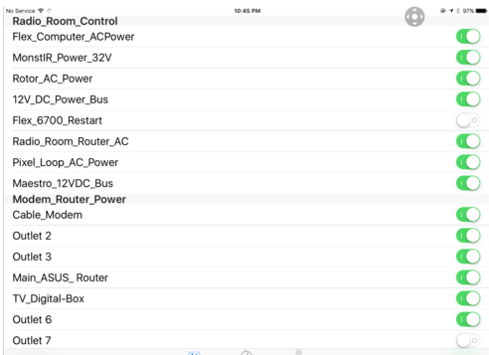
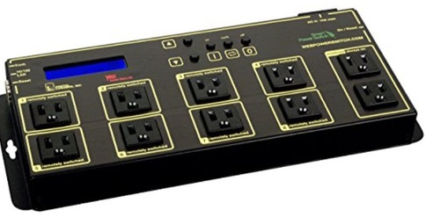
HF Fully Automated HF Remote Station - Issues/Lessons Learned
Equipment for Internet Automation & Interfacing
HF Remote Control Operator – Full Control - It’s your Responsibility !!
What happen if your 1000’s of miles from HF remote and no one is at home to Reset It !!!
Need to be a Responsible HF Remote Control Operator for yourself – others - FCC
Your in Big trouble – Say your 1.5Kw PA stays in transmit – Big trouble !
Your Computer Locks-Up
Your Modem needs rebooting
Your Radio needs resetting
Your Transmitter Locks-Up in Tx
A Stand Alone UPS is not enough !
Software OFF/ON
Switches
Solutions
1.) WEMO Web Controller
2.) Digital Loggers Switch *
Webpowerswitch.com
* Allows scripting programs as well
Built-In Web Server
Via Ethernet
Remote Reboot & Power
Control Via the Web is Essential

Slide 8
The Desktop Method with TeamViewer
HF Fully Automated HF Remote Station
The DeskTop Interface
The Two Most Important Panels - Where it all happens !
PSK Reporter
&
Digital Mode Interface

Slide 9
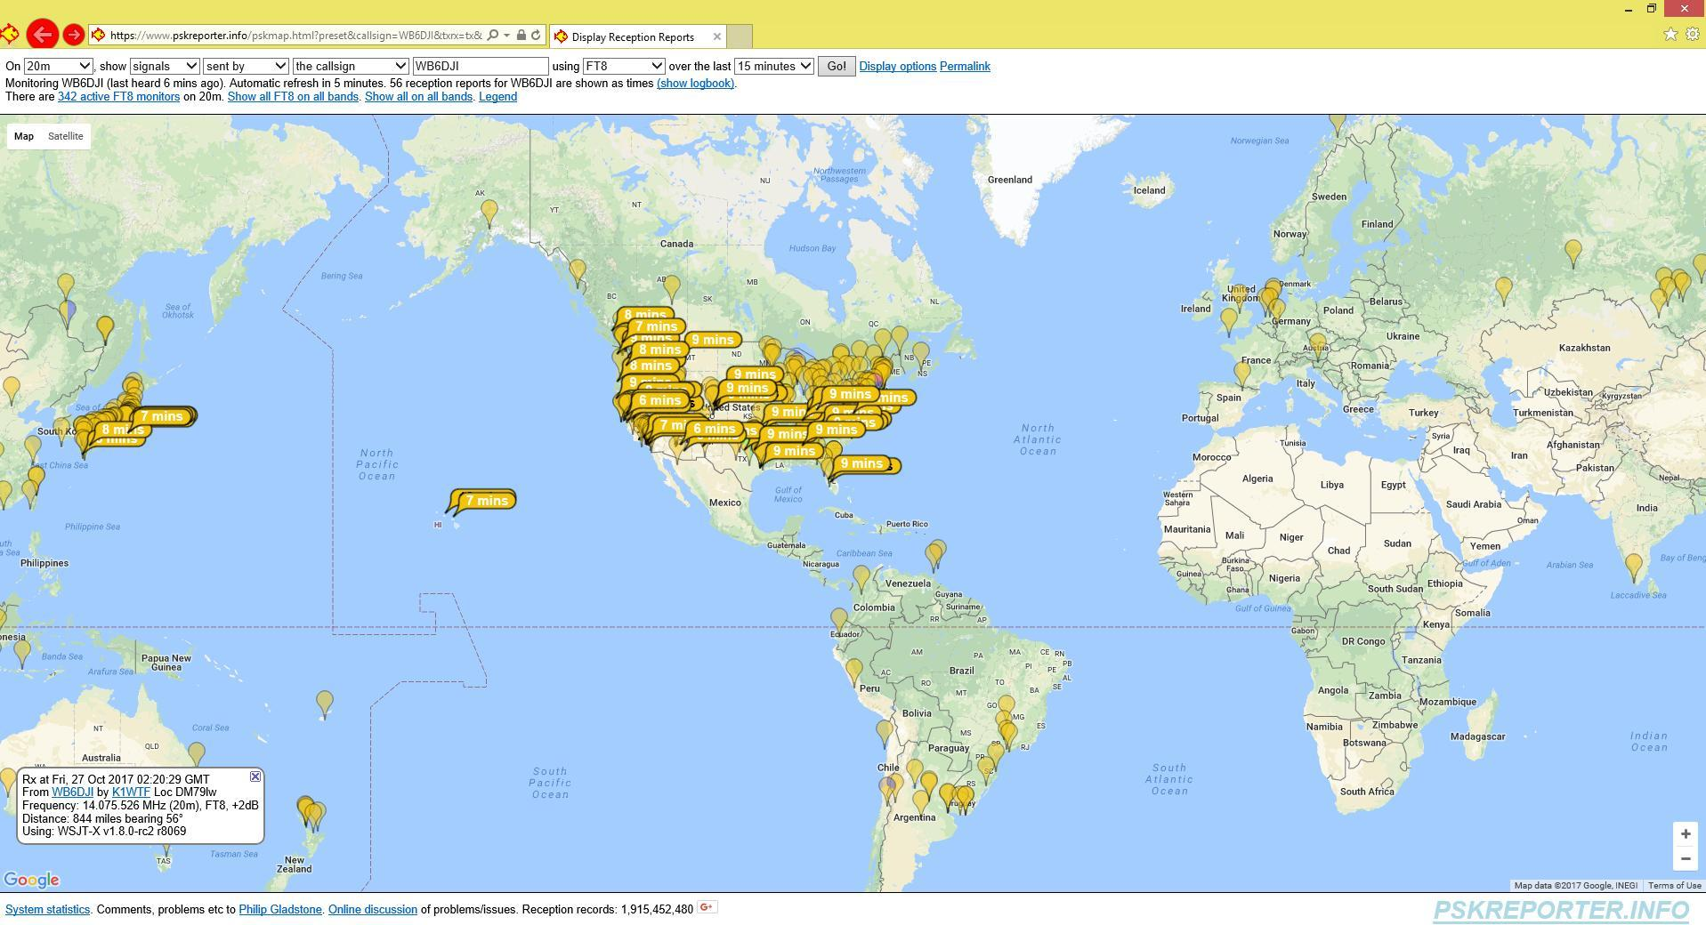
The Desktop Method with TeamViewer
HF Fully Automated HF Remote Station PSK reporter
Important Web Tool - Where can I be heard in the World when I transmit ?
Check to see if the Band is open - Many Stations are listening 24h/7days each day
Similar to Reverse Beacon Network for CW but for Digital Modes
https://www.pskreporter.info/pskmap.html
20 meters Band PSK Reporter Great Tool for the Digital Mode Enthusiast
World Map
Flags show in how many
Minutes ago I was heard
And my Signal Strength any
Where in the World
( Great way to check Propagation )

Slide 10
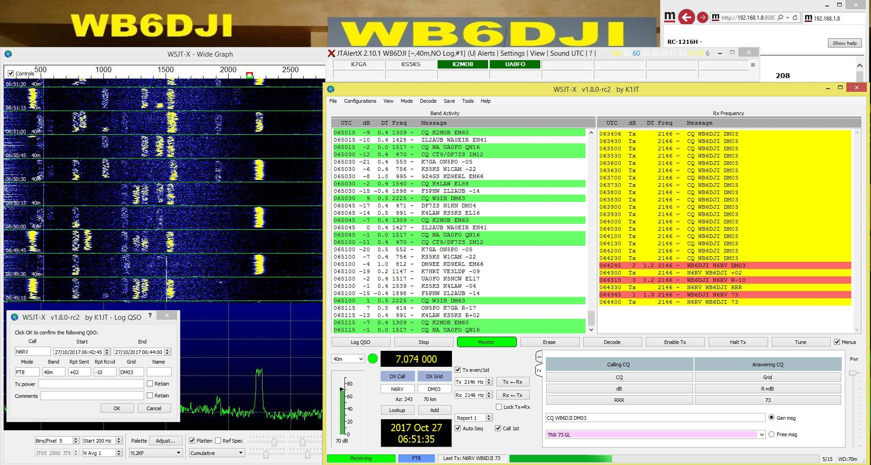
The Desktop Method with TeamViewer
HF Fully Automated HF Remote Station in the WSJT-X Digital Interface
Most Important Panel - Where it all happens !
The JT Alert Box
Red are Rx Exchanges : N6RV
Yellow are My Tx Exchanges : WB6DJI
Digital Mode WaterFall Spectrum
200Hz to 3Khz Panel
See the Signals
Shows all Band Activity
Panel Here
Green is Active CQ Calls
Log Contact Panel Here
QSO Exchanges
CQ to 73 Exchanges
So Let’s Get Started with the Live Demo Now !
This is what we hope to see !

Slide 11
Appendix

