Slide 1
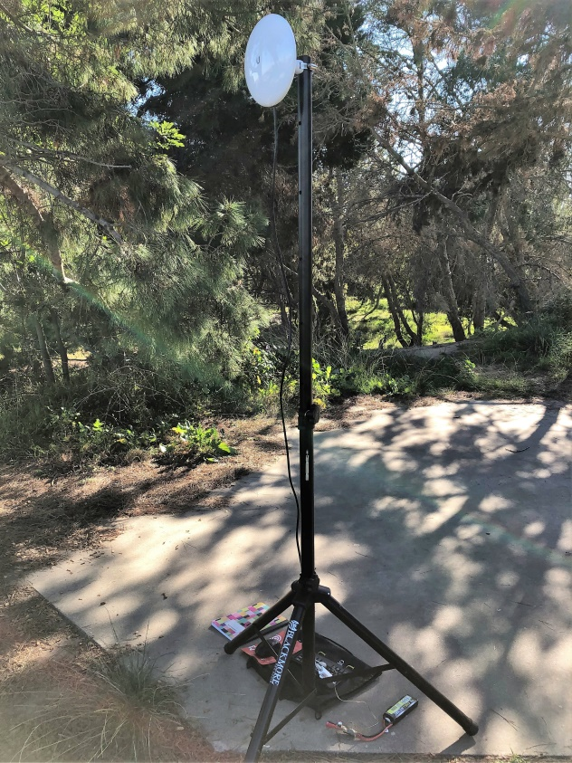
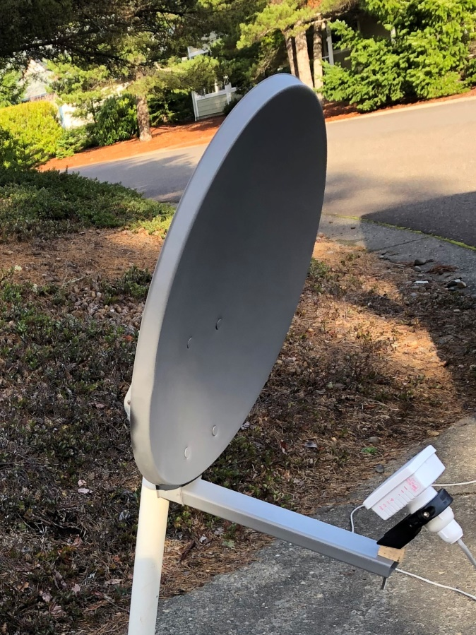
AREDN Mesh Networking
W6HA ARC
By: Brian Johnson, AB6UI Feb 2019

Slide 2
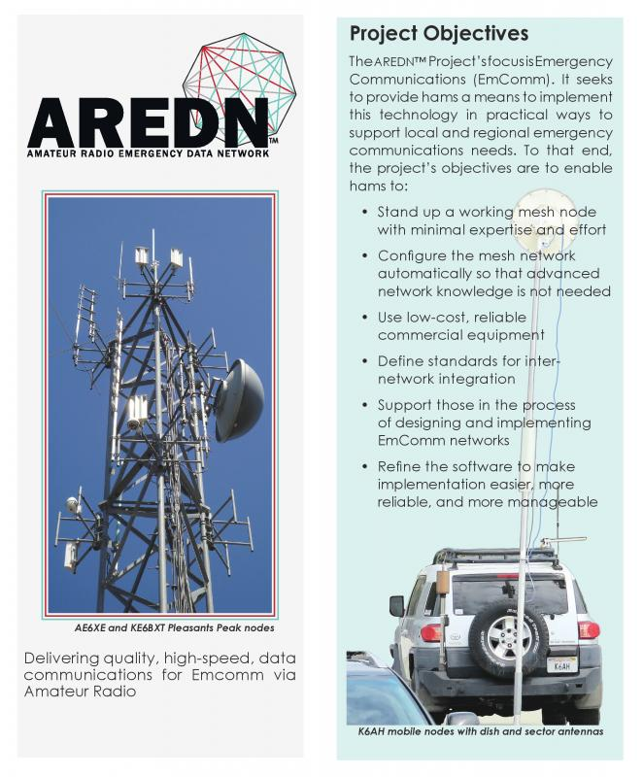
What is AREDN Amateur Radio Emergency Data Network
The primary goal of the AREDN™ project is to empower licensed amateur radio operators to quickly and easily deploy high-speed data networks when and where they might be needed, as a service both to the hobby and the community. This is especially important in cases when traditional “utility” services (electricity, phone lines, or Internet services) become unavailable. In those cases an off-grid amateur radio emergency data network may be a lifeline for communities impacted by a local disaster.
https://www.arednmesh.org/

Slide 3
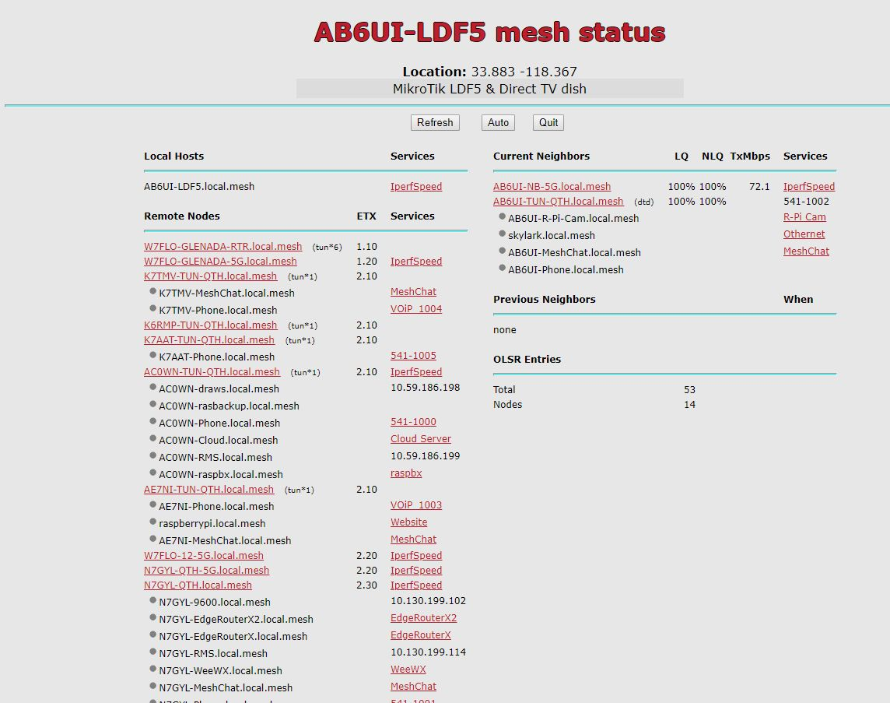
The AREDN network allows all types of data transfer during an emergency.
What types of data?
Almost anything you can think of.
Voice communication (VIOP)
Mesh Chat
Video
E-mail
Cloud Server
Weather info
Geo Sync Sat Links
Etc
The “E” in AREDN stands for Emergency.
Notes:
Talk about PBX, Mesh Chat, Email, gateway to Winlink, Web cams, etc…

Slide 4
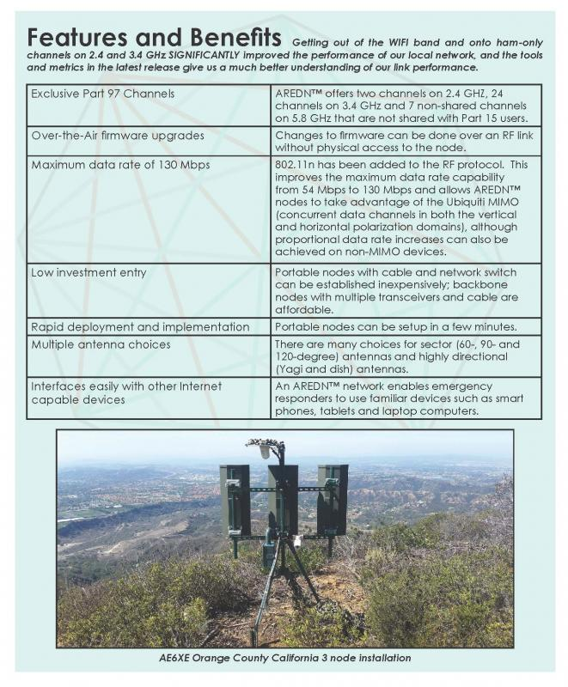
Features and Benefits
https://www.arednmesh.org/

Slide 5
Your first Node
Current As of AREDN™ 3.18.9.0 (updated on 01/06/2019)
Manufacturer/Model | Band
 | 900Mhz | 2.4Ghz | 3Ghz ⁽⁵⁾ | 5.8Ghz
Ubiquiti Networks (www.ubnt.com)
AirGrid (XM revision/old) |  | M2 |  | M5
AirGrid (XW) |  |  |  | AG-HP-5Gxx
AirRouter |  | M2
AirRouter HP |  | M2
Bullet |  | M2 |  | M5
Bullet Titanium |  | M2 |  | M5
Bullet (XW) |  | M2**
NanoBeam (XW) |  | NBE-M2-13 |  | NBE-M5-16/19
NanoBridge | M9 | 2G18 | M3 | 5G22/5G25
NanoStation Loco (XM) | M9 | M2 |  | M5
NanoStation Loco (XW) |  | M2 |  | M5
NanoStation (XM) |  | M2 | M3 | M5
NanoStation (XW) |  | M2 |  | M5
PicoStation |  | M2
PowerBeam ⁽³⁾ |  | PBE-M2-400 |  | PBE-M5-300/400/400ISO
PowerBeam |  |  |  | PBE-M5-620
PowerBridge |  |  |  | M5
Rocket (XM) | M900 | M2 | M3 | M5
Rocket (XW) |  | M2** |  | M5
Rocket Titanium |  | M2 |  | M5
Rocket Titanium (XW) ⁽⁴⁾ |  |  |  | M5
TP-Link
CPE (v1.0) |  | CPE210 |  | CPE510/CPE520
CPE (v1.1) |  | CPE210 |  | CPE510
CPE (v2.0) |  | CPE210 |  | CPE520
CPE210 (v3.0) |  | CPE210
CPE220 (v3.0) |  | CPE220**
CPE610 |  |  |  | CPE610**
Mikrotik
LHG (Lite Head Grid) |  | RBLHG-2nD |  | RBLHG-5nD**
LHG HP XL |  | RBLHG-2HPnD-XL |  | RBLHG-5HPnD-XL**
Basebox |  | RB912UAG-2HPnD |  | RB912UAG-5HPnD
hAP AC Lite (dual band) |  | RB952Ui-5ac2nD |  | RB952Ui-5ac2nD **
LDF (Lite Dish Feed) |  |  |  | RBLDF-5nD**
-
GREEN = "GO" | AREDN Stable
RED="STOP" | Unknown or Support to be determined
ORANGE="CAUTION" | High Confidence of compatibility. Included in current release, but not rigorously tested
YELLOW="RESEARCHING" | Under research/testing
GREY="N/A" | No such device
** | Release candidate (or Nightly build) firmware available
There are many factors when it comes to setting up a node. A fundamental issue is that the hardware must be “flashed” with AREDN firmware. So it is critical that the hardware you obtain is supported. The two main brands are currently supported MikroTic and Ubiquity.
It helps to be familiar with IP addresses, DHCP and other “networking” protocols. Remember you are basically setting up a network that is using RF instead of the “Ethernet”. All of this is done using LINUX code that is running on your Node so having a basic understanding of LINUX commands is very helpful.
You can follow the steps for flashing your node in the “how to” section on the AREDN web site. There are several good tutorials on YouTube and help is available in the forums. It can be tricky! And it is possible to “brick” your device. So it is not a bad idea to get help from someone who has done it before.
Although this may sound like a daunting task with a little reading and some help from an Elmer it is a lot of fun!
Several club members are knowledgeable in AREDN

Slide 6
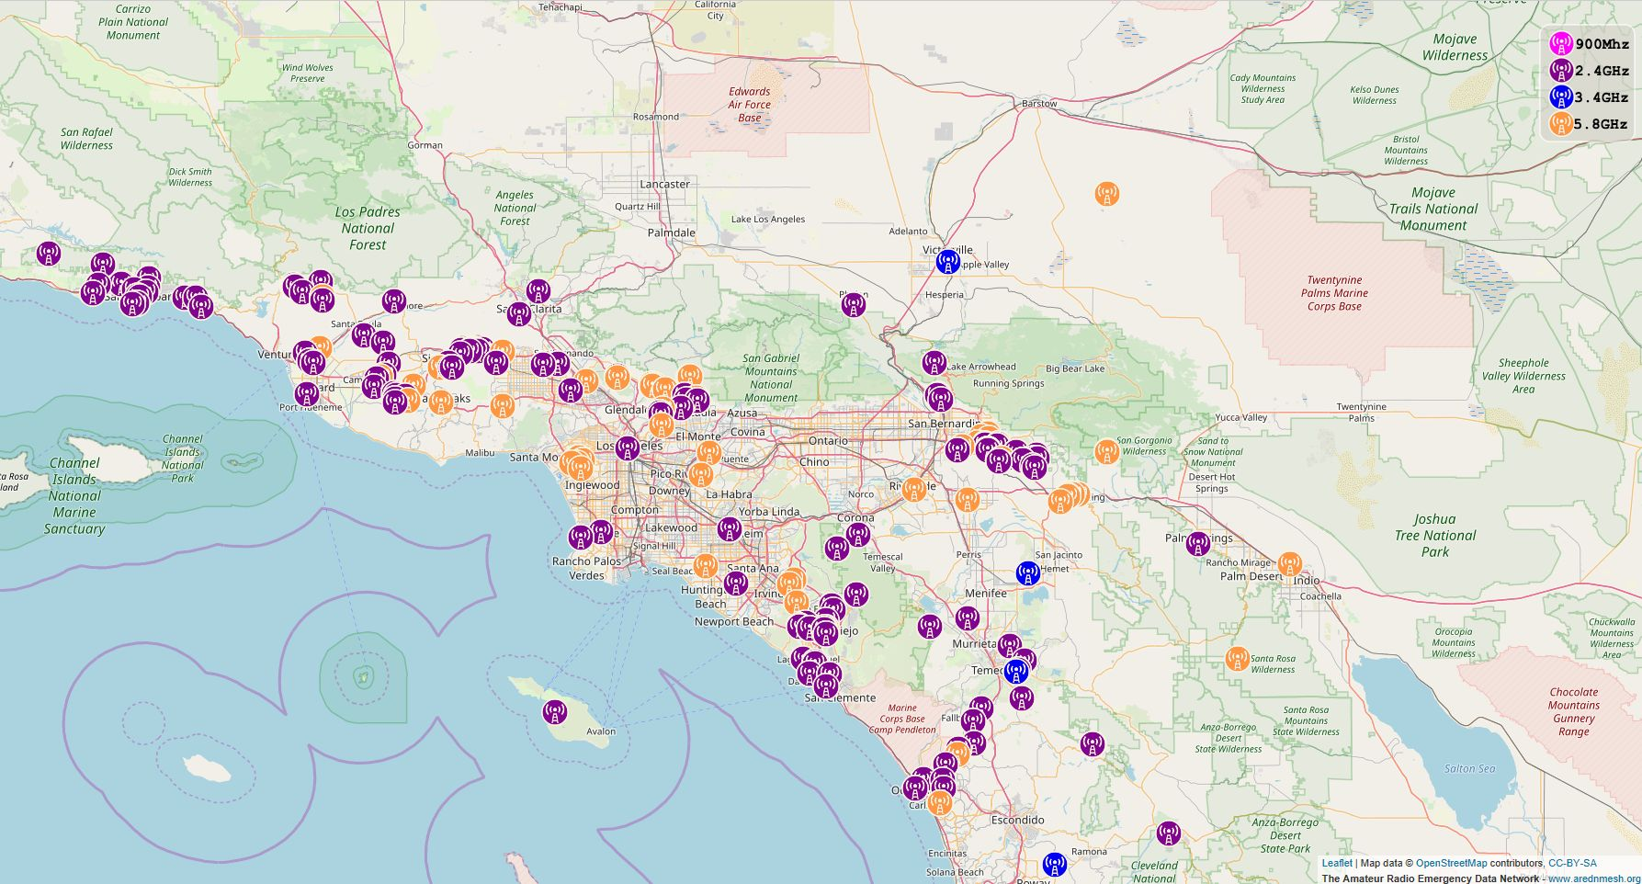
Other concerns
You must decide which node you want to try and connect to. this will drive the band you will use. The distance to the node is also a key concern. If the node is far away you may need a higher gain antenna and more powerful “radio”.
Line of sight is critical!

Slide 7
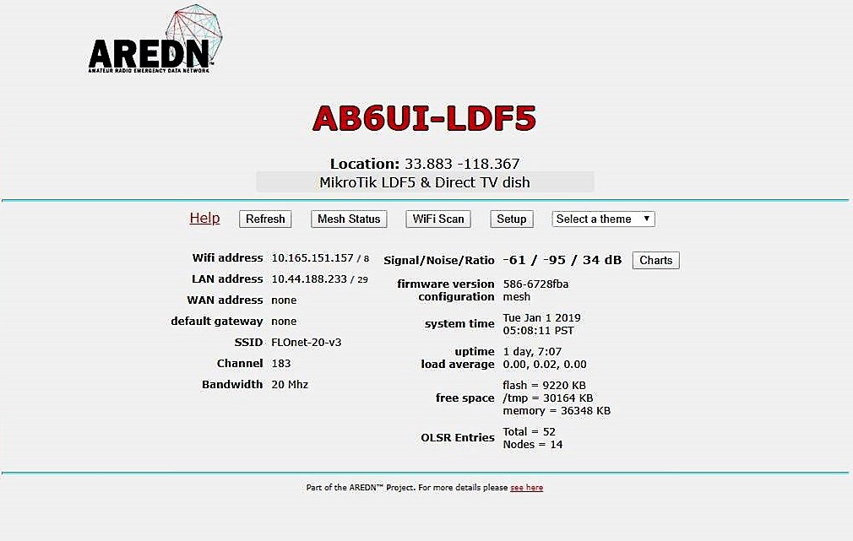
Flashing
Re-flashing your “node” is to involved to go into in this presentation
It is a step by step process and is specific to the type of hardware you are using.
Once you finally get your node up and running your screen will look something like this…
Several club members are knowledgeable in AREDN

Slide 8
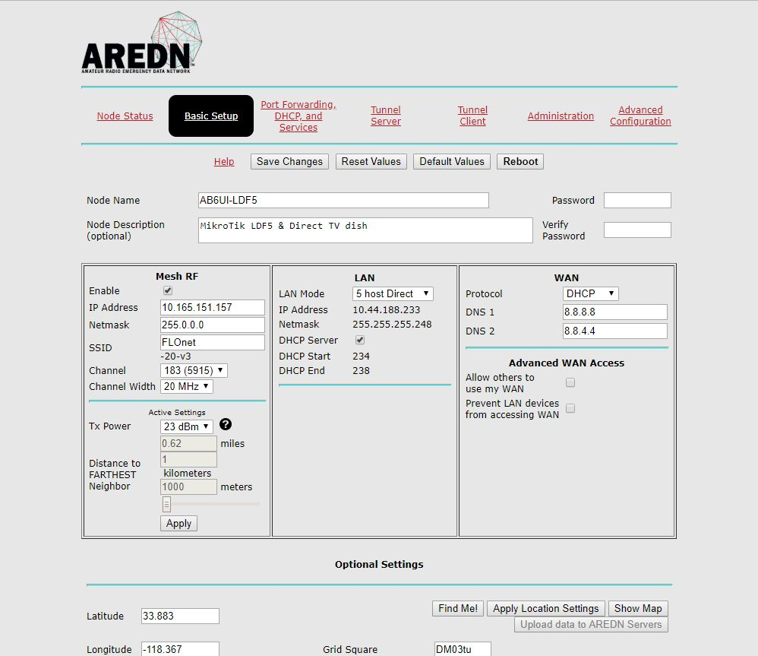
Setup
There are also a few important items in “Basic Setup” that must be completed
Node Name & Description
SSID, Channel & Channel Width (
This should match the node you wish to connect with)
Tx Power & Distance (Note:
The distance must be GREATER THAN zero!
Lat, Long & Grid Square
Several club members are knowledgeable in AREDN

Slide 9
Demo Time
Keep in mind that you are radiating microwaves

Slide 10
Web links
Web pages
https://www.arednmesh.org/
https://mapping.kg6wxc.net/meshmap
https://sites.google.com/site/orangecountymeshorganization/home
Questions?

