Slide 1
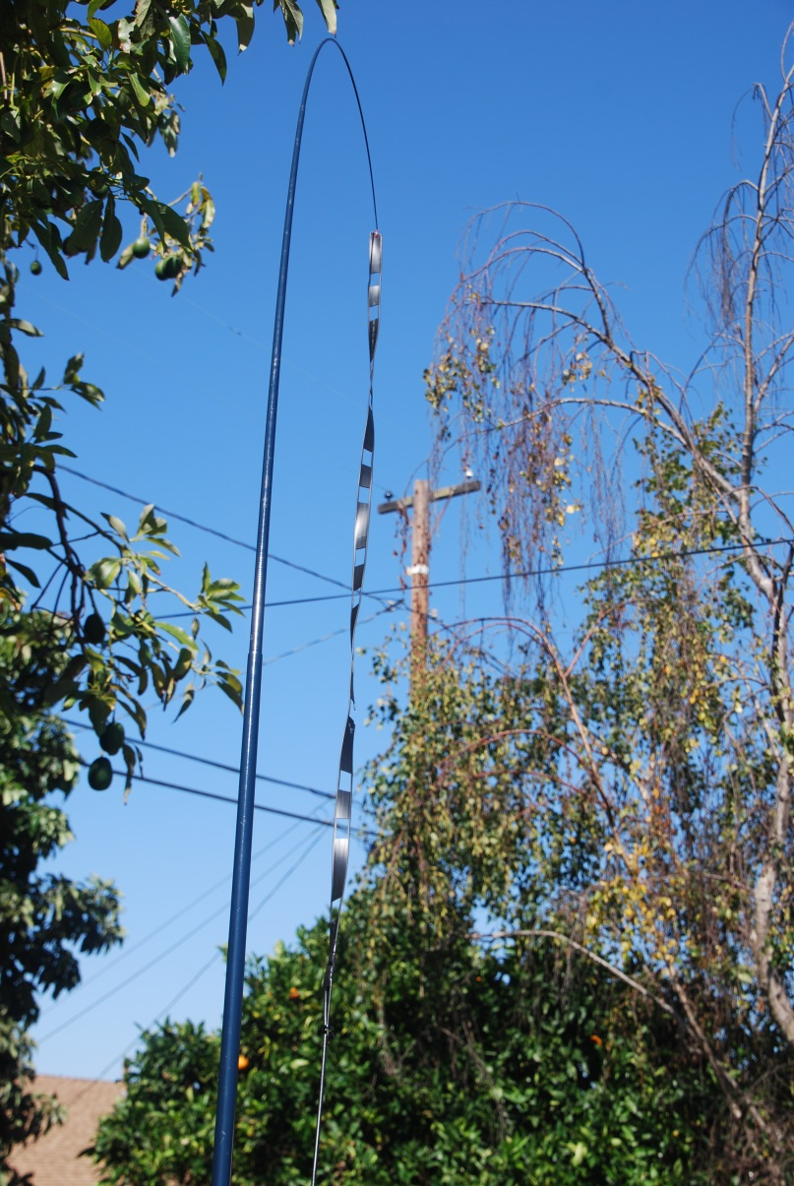
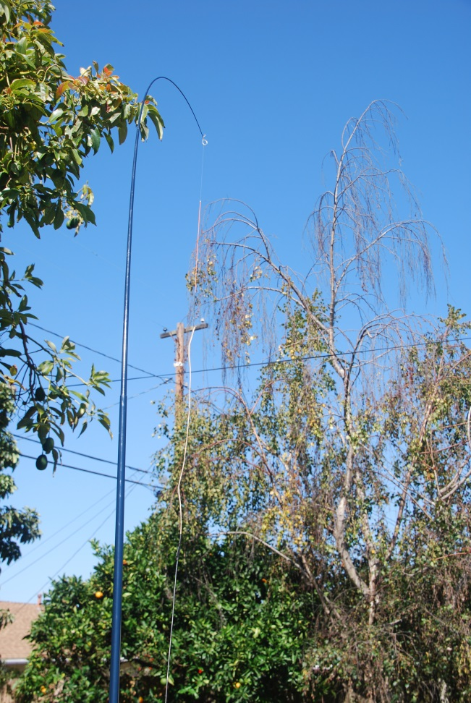
Do It Yourself VHF-UHF Antennas for your Go Bag
W6HA ARC
by Brian Johnson, AB6UI

Slide 2
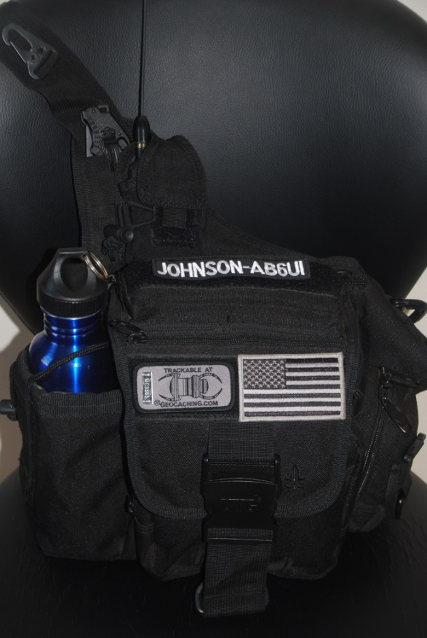
What is a Go Bag ?
Every ham radio Operator should have a go-bag ready for an emergency.
You can't carry everything and everyone has a different opinion about what is important.
Your go-bag should be based upon your operating mode, experience and local conditions.
It is better to have the bare essentials always handy than to leave a bulky pack someplace where you can't get to it.
There are many valuable on-line resources
http://www.races.org/gokit.htm

Slide 3
“Rubber-Duck” antennas are marginal at best
For a local repeater a “Rubber-Duck” antenna may be acceptable. But in the event of a prolonged power outage the ability to perform simplex operation is essential.
The antennas discussed in this presentation are easy to construct, low cost and are very compact.
They offer significant improvement in performance on both the VHF and UHF bands compared to the stock “Rubber-Duck” included with a hand held transceiver.
Are a valuable asset for emergency applications.

Slide 4
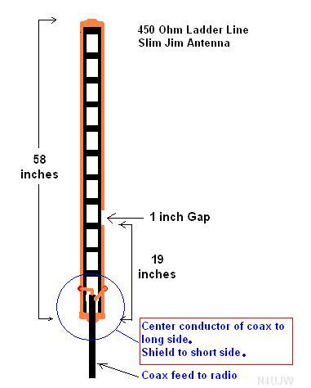
The 450 OHM Ladder Line 2M Slim Jim Antenna
Want to homebrew an antenna for 2M?
Want something that actually works well?
Want to get it up and running in an hour or less?
Enter the slim jim variation on the jpole.
The 450 OHM Ladder Line Slim Jim Antenna

Slide 5
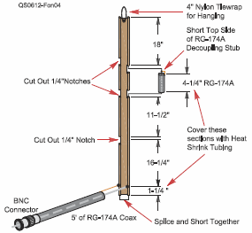
The 300 OHM “TV” Line Dual Band J-Pole Antenna
This antenna can easily fit inside a “go bag” or a large pocket.
It is far less complex than what would be needed for a single band ground plane
This antenna will consistently outperform a ground plane using 3 or 4 radials.
Construction time about 1 hour
Setup time is less than a minute.
Fong "The DBJ-2" a VHF-UHF J-Pole

Slide 6
Conclusion
The examples presented show how to make a portable “roll-up” antenna for your go-bag
Both antennas are easy to construct, are low cost and very compact.
Both provide a significant improvement in performance over a “rubber-duck”
Now, go make something homemade. Lemonade would be nice on a hot day!

Slide 7
Backup
Cost for 300 OHM dual band antenna
3 ft 300 OHM “TV wire” $1.20
5 ft RG-174 $1.45
1 BNC Male $0.60
Misc 20GA wire & Shrink Tube $0.75
TOTAL ~ $4.00

