Slide 1
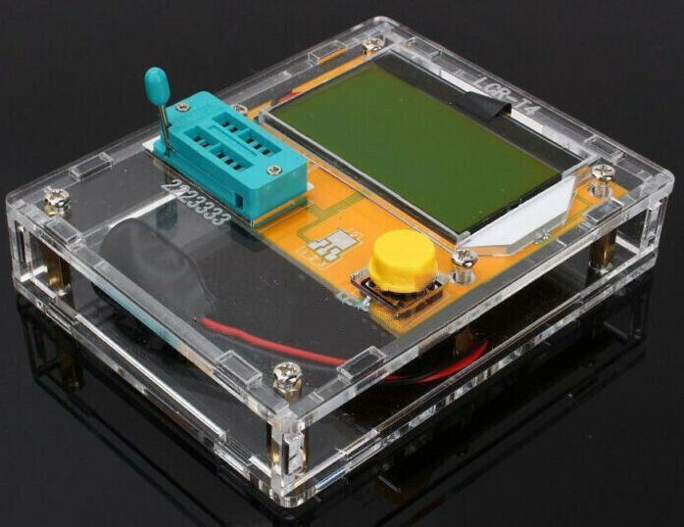
Mega328 Transistor/Component Tester
By: Brian Johnson, AB6UI 17 March 2020

Slide 2
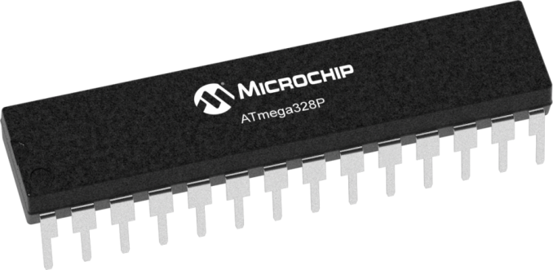
Arduino Atmega328
Technical Specifications:
The Atmega328 is a high-performance Microchip 8-bit AVR RISC-based microcontroller
32KB ISP flash memory with read-while-write capabilities,
1KB EEPROM
2KB SRAM
23 general purpose I/O lines
32 general purpose working registers
3 flexible timer/counters with compare modes, internal and external interrupts
Serial programmable
USART, a byte-oriented 2-wire serial interface,
SPI serial port,
6-channel 10-bit A/D converter (8-channels in TQFP and QFN/MLF packages),
Programmable watchdog timer with internal oscillator
Five software selectable power saving modes. The device operates between 1.8-5.5 volts.
By executing powerful instructions in a single clock cycle, the device achieves throughputs approaching 1 MIPS per MHz, balancing power consumption and processing speed.

Slide 3
Features of the Mega328 Tester
* Latest M328 version of the software, Atmega328 Chip
* 128x64 Big Backlight LCD Display
* Automatic detection of NPN and PNP transistors, n-channel and p-channel MOSFET, diode (including double diode), thyristor, transistor, resistor and capacitor and other components
* Automatic test the pin of a component, and display on the LCD
* Can detect the transistor, MOSFET protection diode amplification coefficient and the base to determine the emitter transistor forward biased voltage
* Measure the gate and gate capacitance of the MOSFET threshold voltage
* Use 12864 liquid crystal display with green backlight
* One -button operation, automatic shutdown
* Only 20nA shutdown current.
* Automatically detect NPN, PNP bipolar transistors , N -channel and P -channel MOS FET, JFET , diodes, two diodes, thyristors small power unidirectional and bidirectional thyristor
* Automatic identification components pin arrangement
* Measuring bipolar transistor current amplification factor and base - emitter threshold voltage
* Through the base - emitter threshold voltage and high current amplification factor to identify Darlington transistors
* Can detect bipolar transistors and MOS transistors protection diodes
* Measuring the gate MOS FET threshold voltage and the gate capacitance
* Can simultaneously measure two resistors and resistor symbol is displayed
* Resistance measurement resolution is 0.1 ohms , 50M ohms can be measured .
* Can measure capacitanceCan measure capacitance of 30pF-100mF , resolution 1pF
* 2uF more capacitors can simultaneously measure the equivalent series resistance ESR values, the two can be displayed with a decimal value , resolution 0.01 ohms.
* Can be in the correct order and the diode symbol display two diodes , and gives the diode forward voltage.
* LED is detected as a diode forward voltage higher . Combo of the LED is identified as two diodes.
* Reverse breakdown voltage is less than 4.5V Zener diode can be identified
* Can measure a single diode reverse capacitance

Slide 4
Putting it all together
A short video clip of it all in action

Slide 5
Backup
Orbitron
NooElec
Male MCX to Female SMA Adapter

