Slide 1
HINTS & KINKS EASY HAM PROJECTS
6 M Delta Loop on a Fiberglass Mast 20 M + 40 M < 40’ End Fed Halfwave uBITX QRP 80 – 10 M CW/SSB Transcerver
Now UPDATED and a better buy!

Slide 2
6 M Delta Loop on a Fiberglass Mast
This was driven by not being able to get a beam installed at my home. Taking from the Spyder Pole idea of using a telescopic pole for a quad I decided on a Delta Loop for my 6 M activity, and also used an MFJ-1911 pole for the basis of it. This mast can be easily erected using a roof mount tripod staked into the ground. MATERIALS 1 @ MFJ-1911 mast, well used 1 @ ½” PVC cross fitting 21’ #18 or larger wire 3.5 feet 75 ohm coax – ¼ wave transformer actual length 3.08’ solder, liquid electrical tape, SO-239, zip ties 2 @ 3’ spreaders; ½” pvc or fiberglass or be creative CUTTING THE WIRE/CABLE
The antenna wire is 1005/f = length (ft) for 50.13 that is 20.05 feet 20’0.6’’
The coax balun is ¼ wave/f expressed as 234/50.13 = 3’0.96” end of cable to end of cable.

Slide 3
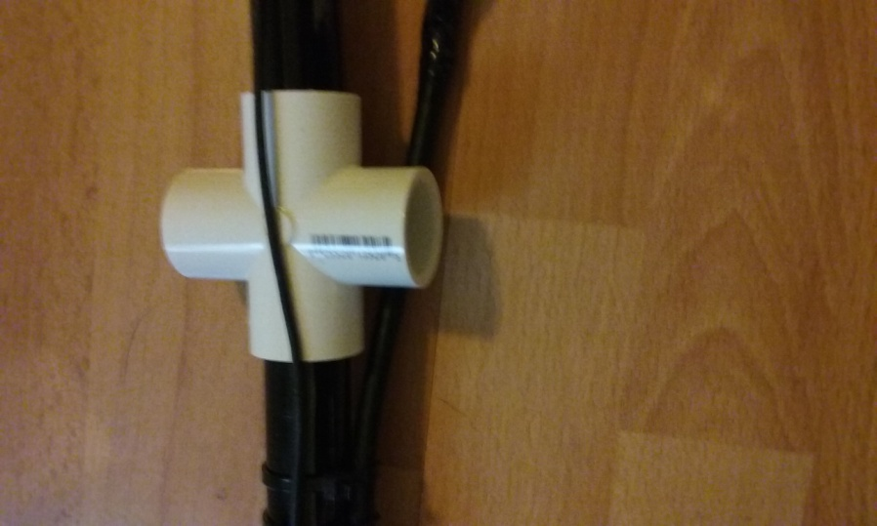
6 M Delta Loop on a Fiberglass Mast
Assembling the Antenna Cut the wire to 20’ ½” and strip the ends Solder one end to the shield of the 3’ 1” coaxial transformer Solder other end of transformer to coax lead in or connector – shield to ground and center conductor to center pin. The Loop is now complete. Insert the two spreaders into the cross piece securely Using wire ties or similar attach the loop to the spreader with the loop to coax connection at one and with the coax running along the spreader. Wire tie the coax in place and then use a wire tie to secure the wire at the opposite end of the spreader.

Slide 4
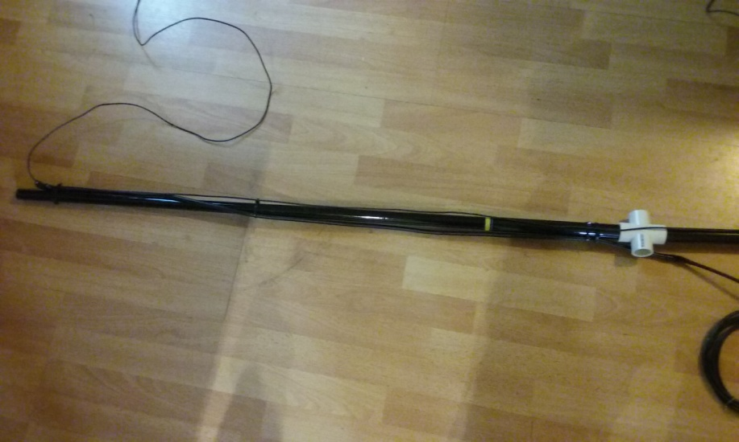
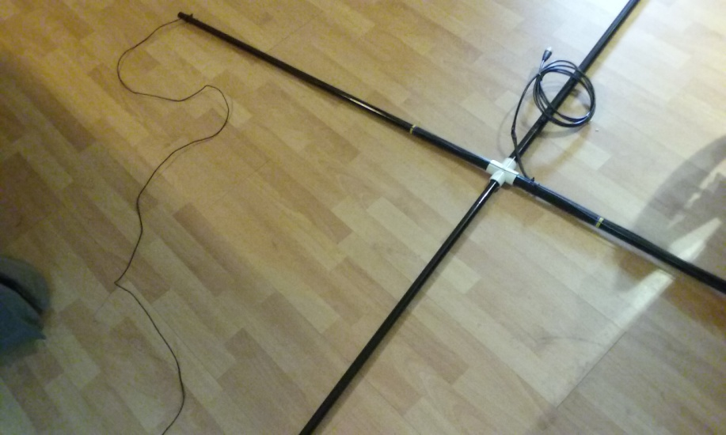
6 M Delta Loop on a Fiberglass Mast

Slide 5
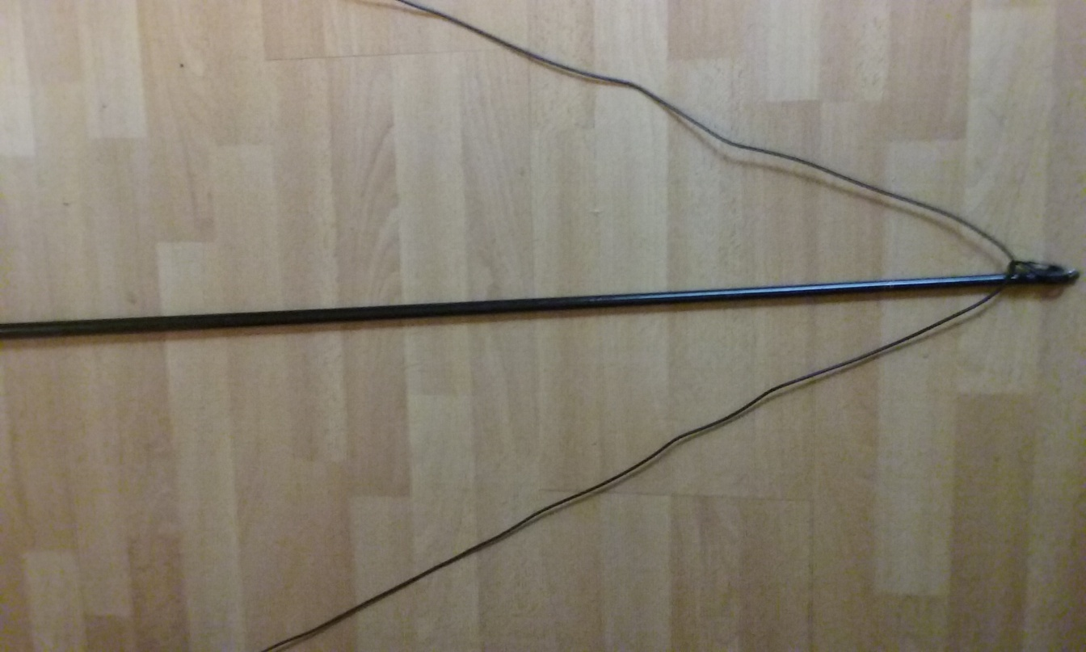
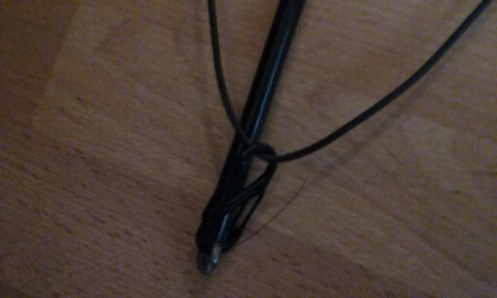
6 M Delta Loop on a Fiberglass Mast
Extend the wire into a triangle and tie off to top of mast, I favor the plastic S-biners for this task. The antenna is now complete and ready to verify SWR and then trim if required and use.

Slide 6
20 M + 40 M < 40’ End Fed Halfwave
Perfect for limited space, and being an end-fed antenna can be put up with only one mast. Also, for those of you with a Spyder Pole 12m – you can have a 20M/40M vertical dipole.
I will not address the construction of the 49:1 transformer, this is just for the radiator wire. MATERIALS
40 ‘ antenna wire of your choice ~20’ of 24 gauge magnet wire – enamel coated
~ 3 inches of ¾-inch PVC pipe #6 machine screws, flat and lock washers and nuts 1 end insulator
CONSTRUCTION
Drill one hole at each end of pvc pipe to fit the #6 hardware Drill a 1/16” or 3/32” about ¼ inch from the hardware holes, these are used to secure the ends of the magnet wire so the coil can be wound easier and stays as wound.

Slide 7
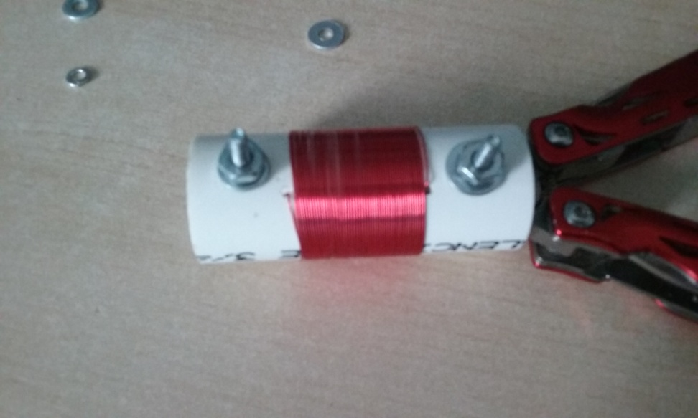
20 M + 40 M < 40’ End Fed Halfwave
CONSTRUCTION cont.
Scrape the insulation from one end of the magnet wire then insert in the small wire hole. Using the #6 hardware secure it on the inside of the pipe.
Wind 55 turns on the pipe and then use tape to hold in place while you trim to length and scrape insulation. Feed through the small wire hole and secure using the #6 hardware. Your Choke/Loading Coil is now complete.

Slide 8
20 M + 40 M < 40’ End Fed Halfwave
CONSTRUCTION cont.
The 20 meter radiator should now be cut, I have found 32’ 8” to work quite well, standard caution of prune and tune with your transformer. Attach one end to coil and other to transformer. To the other end of the coil, attach about 10 – 12 feet of antenna wire and an insulator as it is now time for prune and tune. FYI – mine have ended up in the 6 -8 foot range of length.
END GAME
Raise your antenna and have fun! FOR REFERENCE ON 49:1 TRANSFORMER
If you want to build your own transformer this sight has a bunch of info, including 64:1 transformer
Also can buy pre-wound and install in your choice of enclosure
https://www.nonstopsystems.com/radio/frank_radio_antenna_multiband_end-fed.htm
https://www.ebay.com/itm/Balun-Unun-1-49-49-1-For-End-Fed-Half-Wave-EFHW-antenna-500W/283096767858?hash=item41e9e1dd72:g:iHQAAOSw4a1bbdLw

Slide 9
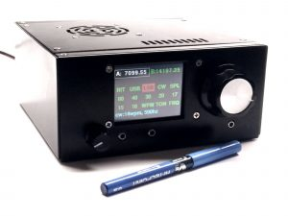
uBITX (microBITX) QRP TRANSCEIVER - UPGRADED
In the past I have brought a uBITX to the club and it was indeed very bare bones. There have been upgrades to the user interface as well as such additions as AGC, a metal case and speaker mic. This is now also essentially a no-solder kit which makes assembly go faster. 80-10M, 5 watt open source radio for just under $200!
https://www.hfsignals.com/index.php/ubitx-v6/

