Slide 1
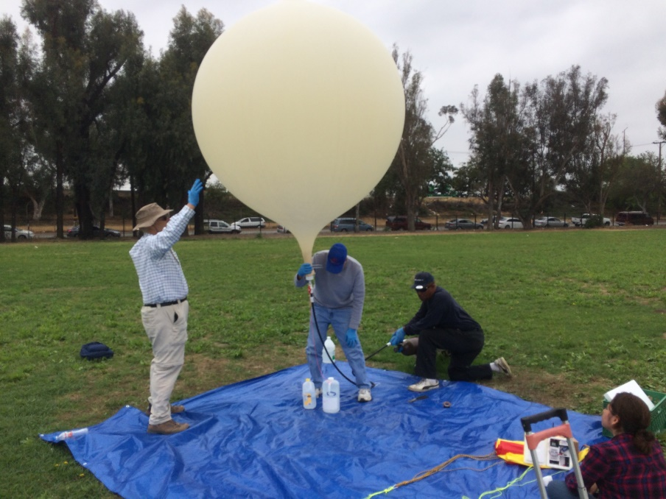
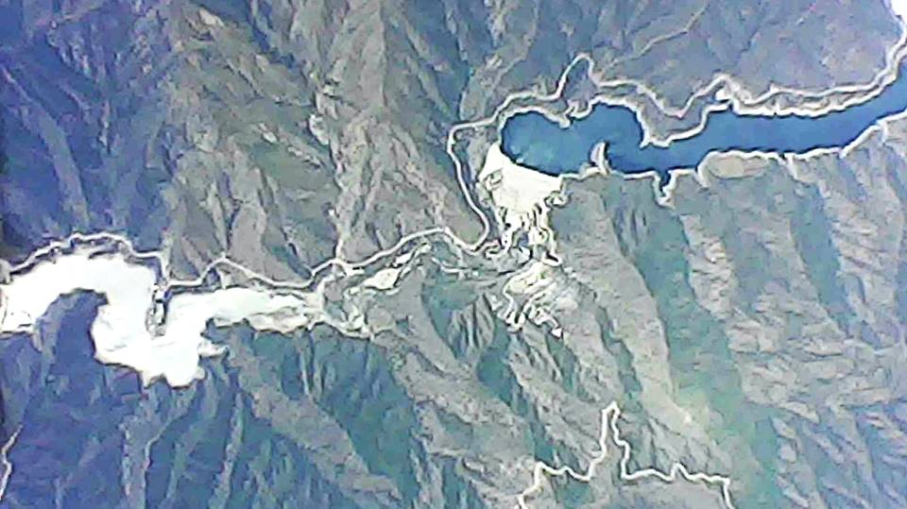
HAB High Altitude Balloon Experiment
W6HA ARC
By: Brian Johnson, AB6UI Aug 2018

Slide 2
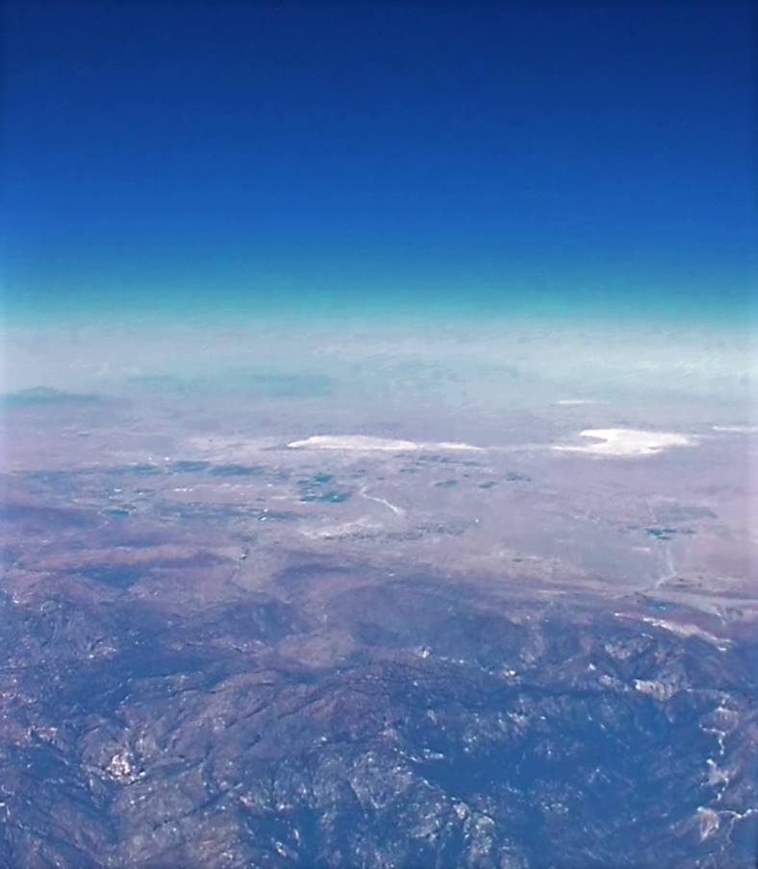
Background
Born in the late 1950s, I was a child of the space race, from the first beeps of Sputnik to Mercury, Apollo, and the Space Shuttle I was hooked. I always dreamed of going or at least sending things into space. For years these high altitudes was the domain of government agencies .
But today it's much easier to reach Earth's outer limits, for the average person, than you might think.
All you need is a big weather balloon, an APRS tracker, a parachute, some helium and a few basic skills.
High-altitude "ballooning" allows hobbyists, and students to view our planet from as high as 100,000 feet. These balloons can capture the curvature of the Earth and fields of endless clouds.
It’s probably the only way an average person can send a payload to the edge of space.
I first had an interest in launching a high altitude balloon in 2012. I approached the science teacher at Da Vinci Academy High School. At first he was very interested and I started acquiring everything I needed. Unfortunately at some point they seemed to loose interest. And so the project was put on hold. Until now!

Slide 3
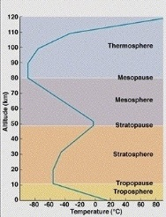
The Lesson Plan
I approached my friend Dr. Kent Schwitkis about the prospect of working with some of his physics students from Compton Jr College to launch and recover a High Altitude Balloon “HAB”. He was very excited about the prospect and once he obtained approvals from the Dean and got a few other educators on board the ball stared rolling.
The goal:
To launch (and recover )a payload to the edge of space or ~50Km above the earth’s surface.
Payload #1:
The students would design, assemble and test a scientific payload with sensors for measuring temperature, pressure, acceleration, humidity, light intensity & cosmic rays.
Payload #2:
This payload would include the APRS tracker and video cameras pointing up, down, and sideways.

Slide 4
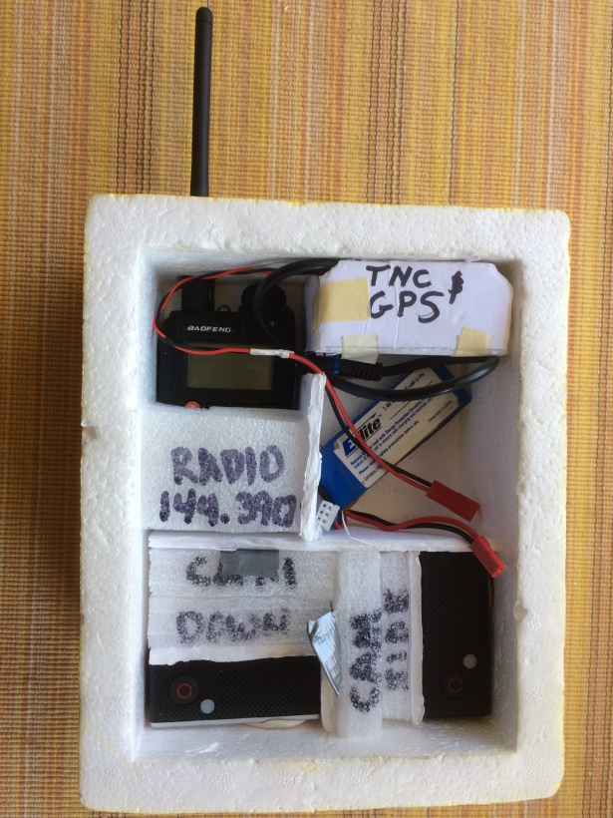
Building a HAB
Balloon:
Meteorological balloons come in different shapes and sizes. The higher burst altitudes require a larger balloon. We chose a 1200g balloon with a ~100,000ft burst altitude.
Automatic Packet Reporting System:
Complete APRS units are available from a few vendors. Being a DIY guy I decided to build my own. The system consisted of the GPSr (UBLOX-6M), TNC (Agent data systems T3 Mini) and Radio (Baofeng UV-3R)
Note: it is actually illegal to use a cellphone as a balloon tracking device per FAA rules
Cameras
We decided on three cameras looking down, up & side. The down and up cameras provide the best photos of the view from space but the up cam is great for capturing change in balloon size during accent and the balloon burst and parachute operation during decent.
Parachute
Parachutes are very important to insure the payload lands safely. Commercial ones are available. Again I followed some simple plans and fabricated my own 60” parachute from rip-stop nylon
Helium
The amount of Helium required depends on the size of the balloon and the weight of the payload.
100 cubic feet of helium will lift 1080g...
200 cubic feet of helium will lift 2961g...
Keep in mind that finding the payload is not guaranteed so price is a key factor!

Slide 5
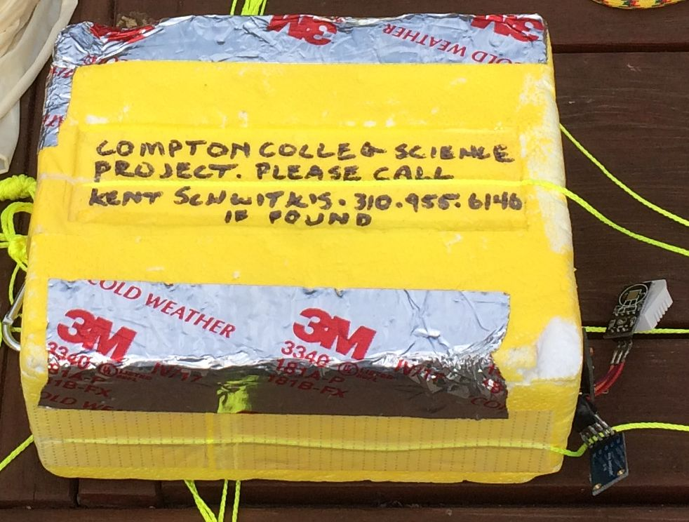
Student Payload
One reason to go to the edge of space is to observe things that change with altitude. Working with the students we came up with the following list of experiments
We used an Arduino Pro Mini to control the following sensors
Sensors
Atmospheric Pressure
Temperature
Cosmic Rays
Light Intensity
We also has a Real Time Clock to “Time Stamp” the data
We also included a Micro SD storage card
So we could compile the data once on the ground
Keep in mind that finding the payload is not guaranteed so price is a key factor!

Slide 6
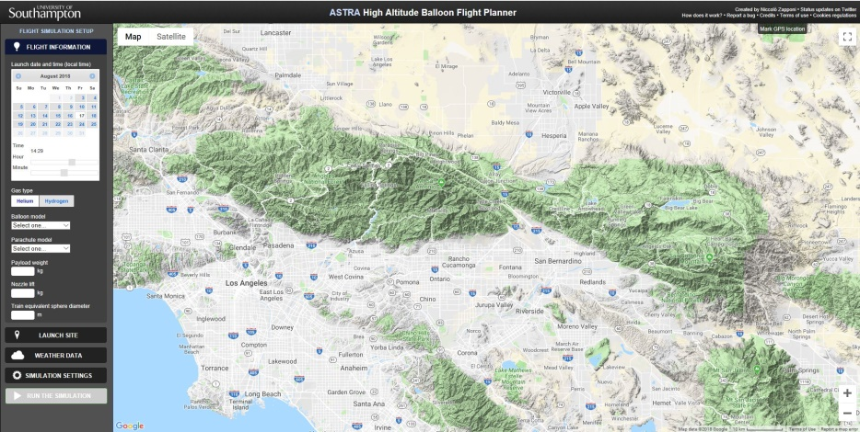
The Planning
It is important that the balloon does NOT do any damage when it lands. So it is important that it does not come down in a densely populated area or on, or near a major highway.
The tool we used to predict the flight path and landing location was ASTRA Planner
Astra Planer is a free web base utility for balloon tracking.
It is relatively simple to use but there is some data you must input into the tool.
Launch date & time
Balloon model (1200g)
Parachute model (60”)
Payload weight (per FAA regulations must not exceed 2kg)
Nozzle lift
This is how much lift you have at he nozzle at launch
This should be about 1.5 times the payload weight
We had a 1kg payload so out nozzle lift was 1.5kg
Launch site
Weather data
Used “on line forecast”
Simulation Settings
For a balloon that goes up, bursts and returns to earth choose standard
10 simulations is usually enough to give you a reasonable idea of the landing sight
Safety is the primary concern

Slide 7
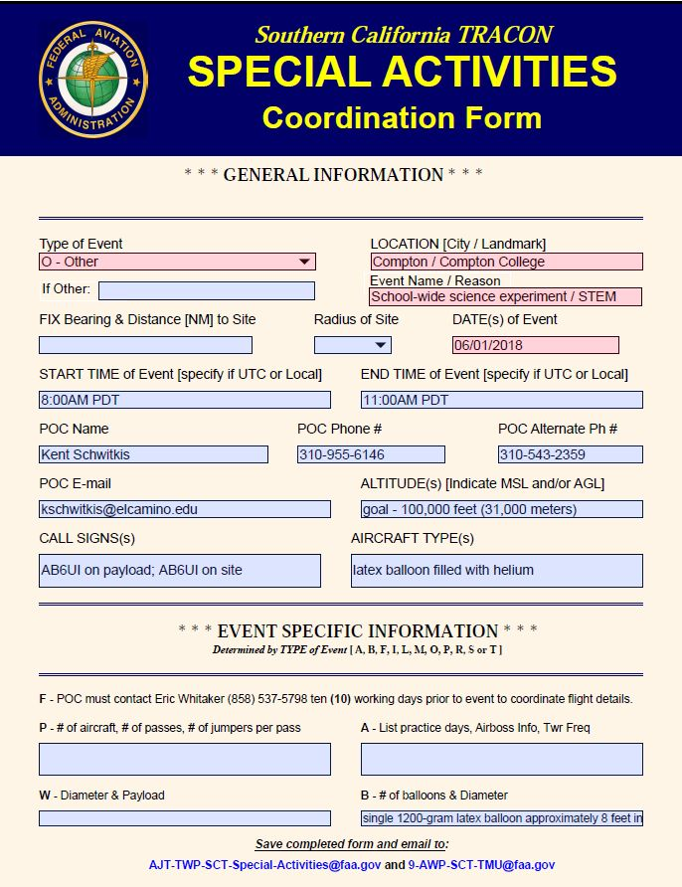
FAA approval
FAA document “CFR-2012-title14-vol2-part101, Sub-part D—Unmanned Free Balloons” is the document you need to refer to…
Prelaunch notice: Except as provided in paragraph (b) of this section, no person may operate an unmanned free balloon unless, within 6 to 24 hours before beginning the operation, he gives the following information to the FAA ATC facility that is nearest to the place of intended operation:
(1) The balloon identification.
(2) The estimated date and time of launching, amended as necessary to remain within plus or minus 30 minutes.
(3) The location of the launching site.
(4) The cruising altitude.
(5) The forecast trajectory and estimated time to cruising altitude or 60,000 feet standard pressure altitude, whichever is lower.
(6) The length and diameter of the balloon, length of the suspension device, weight of the payload, and length of the trailing antenna.
(7) The duration of flight.
(8) The forecast time and location of impact with the surface of the earth.
Prelaunch notice can only be submitted prior to general authorization and that takes 3-5 days!

Slide 8
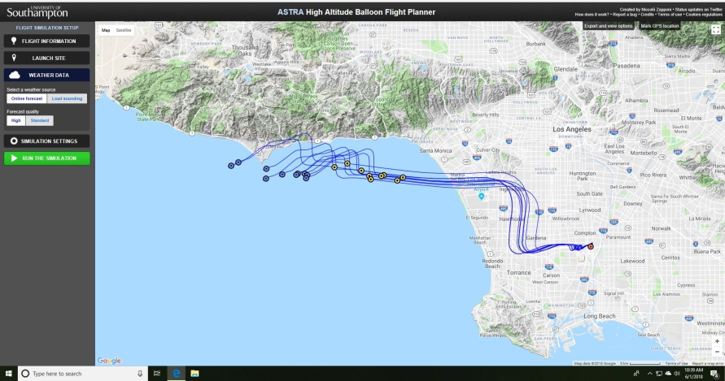
The Launch
We had originally planned to launch Friday June 1st from Compton College. We started the process of coordinating with the FAA Monday July 30th. Unfortunately between Monday and Friday the predicted winds shifted from on-shore to off-shore and the predictions indicated we would land in the Pacific ocean somewhere near Malibu.
We did obtain approval from the FAA, even though the flight path took us right over LAX airspace, But we decided to scrub since recovery would have been nearly impossible. Over the weekend we started looking at future launch dates and Wed June 6th looked promising. So first thing Monday we contacted the FAA to reschedule the launch date. We were told that since it was a totally different flight path such short notice could be a problem.
Friday June 1st
But we started making preparations for a Wed launch. Unfortunately by COB Tuesday we had still not received FAA approval and scrubbed the launch.
However, on Wed at 8am we got FAA approval and the launch was back on!
Although if your payload is under 2Kg FAA notification and approval is not “strictly” required
we wanted to err on the side of caution.

Slide 9
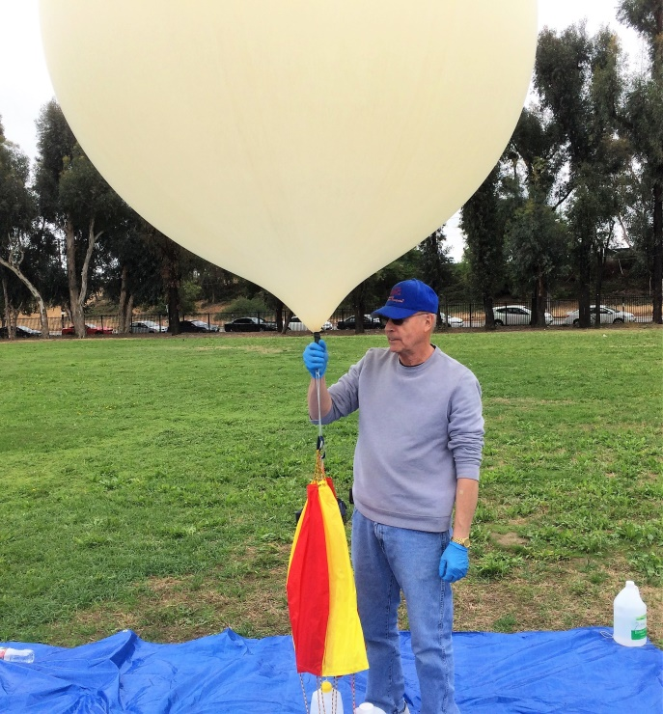
The Launch (cont)
Wednesday morning was a bit hectic. The launch team had to be contacted again, and although some plans had already changed, the core team was assembled. Due to the early morning overcast conditions we had been experiencing we scheduled launch time for 12:30p. The team assembled at the school at about 10 am to begin preparations.
The process of filling the balloon is not too difficult but special care must be taken. Gloves must be worn to prevent the oils from your hands from coming into contact with the balloon. Also you must use just the right amount of helium to provide the appropriate amount of lift. This is actually done by weighing the entire payload (excluding the balloon) and then measuring an appropriate amount of water to be 1.5 times that weight. Once the balloon is able to lift that jug of water you know that the “nozzle lift” is correct.
While the balloon is being filled the payload activation preparation begins. Everything onboard had limited battery power so timing is critical. A checklist is helpful.
APRS on and working
Camera 1, 2, 3 up and running
Scientific payload activated

Slide 10
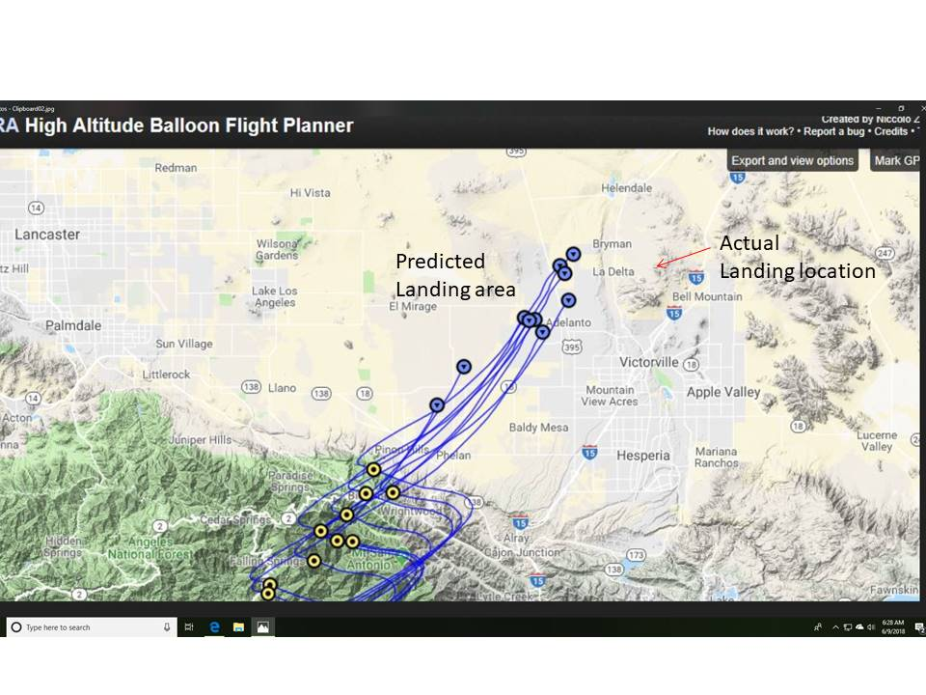
The Flight
We launched from Compton City College at 12:30pm. 6 June 2018.
The computer simulations predicted a burst altitude of 120,000 feet, a flight time of 3 hours and 20 minutes and landing somewhere near Victorville.
The “tracking team” (K6UU & AB6UI) left shortly after launch. Since Astra planner predicted the balloon would land near Victorville. That was out destination. The APRS tracker was working perfectly. Every 2 minutes we got a new position and altitude. The balloon was right on the projected course. We arrived in Victorville and decided to have lunch while we waited for the balloon to catch up.
Then at 16:34 EDT, when the balloon reached 12 km of altitude, the telemetry from the APRS just stopped. After 40 minutes of uncertainty about the fate of the balloon just as mysteriously as the data stopped it started again at 18:14 EDT the data started again. Perfect telemetry every two minutes. The balloon was on its way back down. The tracking jumped back into action we determined that the balloon was landing in a remote area North of Victorville.
In GPS technology, the term "COCOM Limits" also refers to a limit placed on GPS tracking devices that disables tracking when the device calculates that it is moving faster than 1,000 knots at an altitude higher than 12,000 m. This was intended to prevent the use of GPS in ICBM applications.

Slide 11
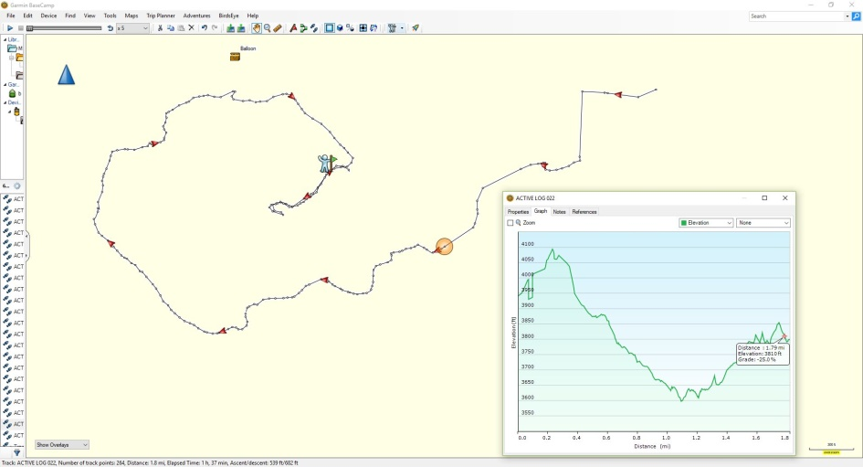
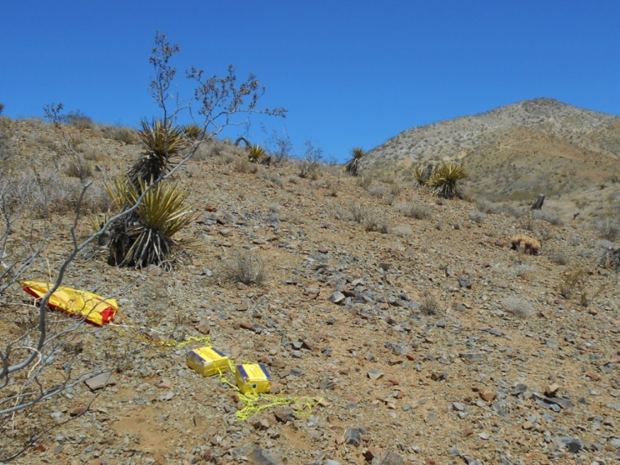
The Search
We had great tracking data of the decent and had a good idea where the balloon landed. We turned off I-15 onto Dale Evans Parkway which almost immediately turned into a dirt road. This was a 4-wheel drive paradise but to my 2-WD Chevy Equinox it was more like HELL…
We were able to drive to the base of a peak and then walk up to the summit. From that vantage point I spotted the parachutes bright red and yellow colors in the desert below. While Norm waited on the top of the peak I hiked down to recover the balloon.
With the help of San Bernardino search and rescue, both Norm and I were finally recovered with the payload in hand.
The scientific data that was obtained is still being reviewed by the students.

Slide 12
Backup slides
The heart of the project is the ability to track and then successfully locate recover the payload. This is all made practical by the use of an APRS tracking device. The following slides are an excerpt from a presentation I made on APRS a couple of years ago. These slides are intended to help explain the basics of APRS with an emphasis on HABs.

Slide 13
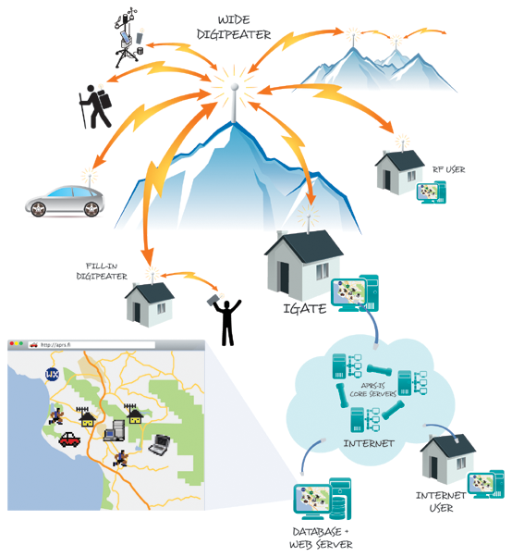
What is APRS?
Automatic Packet Reporting System (APRS) is an amateur radio-based system for real time tactical digital communications of information of immediate value in the local area.^{[1]} Data can include object GPS coordinates, weather station telemetry, text messages, announcements, queries, and other telemetry. APRS data can be displayed on a map which can show stations, objects, tracks of moving objects, weather stations, search and rescue data, and direction finding data.
APRS data is typically transmitted on a single shared frequency (144.390 s) to be repeated locally by area relay stations (digipeaters) for widespread local consumption. In addition, all such data is typically ingested into the APRS Internet System (APRS-IS) via an internet connected receiver (igate) and distributed globally.] Data shared via radio or internet is collected by all users and can be combined with external map data to build a shared live view.
APRS packets are transmitted for all other stations to hear and use. Packet repeaters, called digipeaters, form the backbone of the APRS system, and use store and forward technology to retransmit packets. All stations operate on the same radio channel, and packets move through the network from digipeater to digipeater, propagating outward from their point of origin. All stations within radio range of each digipeater receive the packet. At each digipeater, the packet path is changed. The packet will only be repeated through a certain number of digipeaters—or hops—depending upon the all important "PATH" setting.
it is quite different from conventional packet radio. Rather than using connected data streams where stations connect to each other and packets are acknowledged and retransmitted if lost, APRS operates entirely in an unconnected broadcast fashion, using unnumbered AX.25 frames.

Slide 14
APRS Digipeating and Path Selection 101
WHY DIGIPEATING IS REQUIRED
"Digipeater" is short for "Digital Repeater"; a repeater for packet data rather than voice. Unlike the standard voice repeater that receives on one frequency and retransmits what it hears simultaneously on another frequency, the usual digipeater is a single frequency device. It receives a packet of data, stores it in internal memory and then a moment later retransmits it on the SAME frequency.
The implication of this is profound. Every transmission made on the channel occupies not just the time the original user took to send it, but two, three or more additional time slots depending on the number of digipeater "hops" (retransmissions) requested since digipeating is sequential, not simultaneous. Using just one digipeater cuts the channel capacity (the number of users that can be accommodated per hour in a given area) in half! The indiscriminate use of three, four or more digipeater hops can reduce the channel capacity 75 percent or more.
Digpeating is much more critical to APRS than to conventional packet because APRS heavily involves packet data transmission to and from moving vehicles. [ Traditional packet was overwhelmingly used between fixed locations, typically with better antennas and more power.]
Today's recommended universal path settings are:
Today's recommended universal path settings under the "New Paradigm" are:
WIDE1-1,WIDE2-1 (Will produce two hops and will take advantage of home fill-in digis. Use in busy urban and suburban areas.) Recommended for the majority of mobile operations! WIDE1-1,WIDE2-2 (Will produce three hops and will take advantage of home fill-in digis. Use for mobile operation in rural areas with low APRS activity only!) WIDE2-2 (Shortest path string. Produces two hops by directly using two high-level digis. Will work almost anywhere but especially recommended in the American west where high-level digipeaters are really high-level; i.e. on mountain tops thousands and thousands of feet above users that can easily be reached directly, without the help of home stations.) Note that WIDE2-2 is the ONLY path that works with digipeaters in southern California. WIDE2-1 only (This should be used by fixed stations, and will produce only one digipeater hop. In most cases, fixed stations already have the advantage of a better antenna and elevation than a mobile, and should be able to reach a true wide-area digipeater without the aid of another home station.) Airborne stations above a few thousand feet should ideally use NO path at all, or at the maximum just WIDE2-1 alone. Due to their extended transmit range due to elevation, multiple digipeater hops are not required by airborne stations. Multi-hop paths just add needless congestion on the shared APRS channel in areas hundreds of miles away from the aircraft's own location. NEVER use WIDE1-1 in an airborne path, since this can potentially trigger hundreds of home stations simultaneously over a radius of 150-200 miles.

Slide 15
SSIDs
SSID RECOMMENDATIONS: It is very convenient to other mobile operators or others looking at callsigns flashing by, to be able to recognize some common applications at a glance. Here are the recommendations for the 16 possible SSID's (the limit of 16 comes from the 4 bits available in the AX.25 protocol.
-0 Your primary station usually fixed and message capable
-1 generic additional station, digi, mobile, wx, etc
-2 generic additional station, digi, mobile, wx, etc
-3 generic additional station, digi, mobile, wx, etc
-4 generic additional station, digi, mobile, wx, etc
-5 Other networks (Dstar, Iphones, Androids, Blackberry's etc)
-6 Special activity, Satellite ops, camping or 6 meters, etc
-7 walkie talkies, HT's or other human portable
-8 boats, sailboats, RV's or second main mobile
-9 Primary Mobile (usually message capable)
-10 internet, Igates, echolink, winlink, AVRS, APRN, etc
-11 balloons, aircraft, spacecraft, etc
-12 APRStt, DTMF, RFID, devices, one-way trackers*, etc
-13 Weather stations
-14 Truckers or generally full time drivers
-15 generic additional station, digi, mobile, wx, etc
Note: The SSID of zero is dropped by most display applications. So a callsign with no SSID has an SSID of 0.

Slide 16
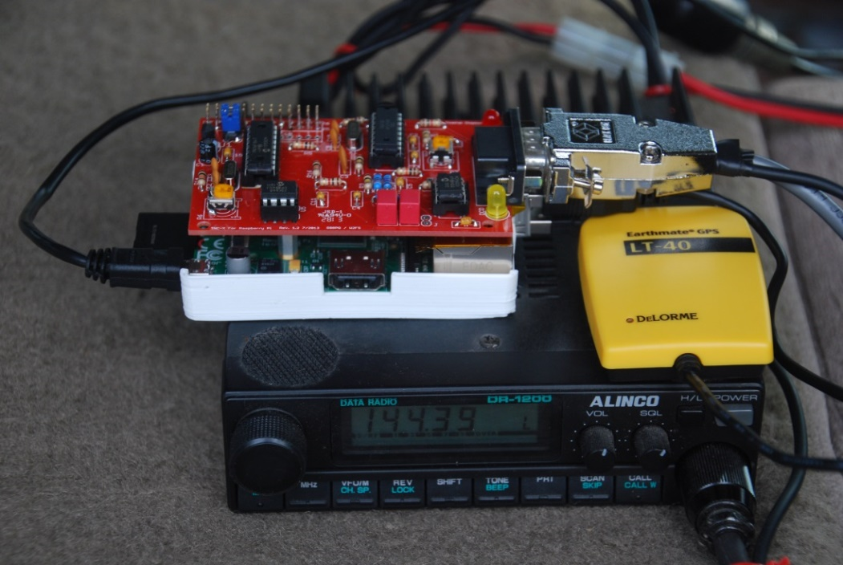
Automatic Position Reporting Station
Xastir Software
TNC-Pi
R-Pi Computer
GPSr provides Lat & Long
2 M XCVR

Slide 17
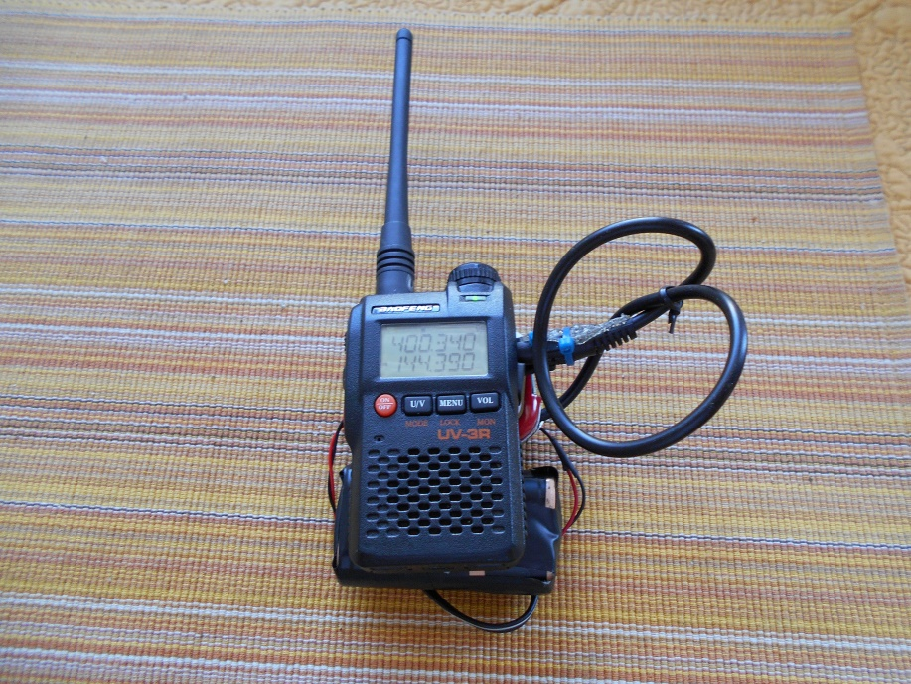
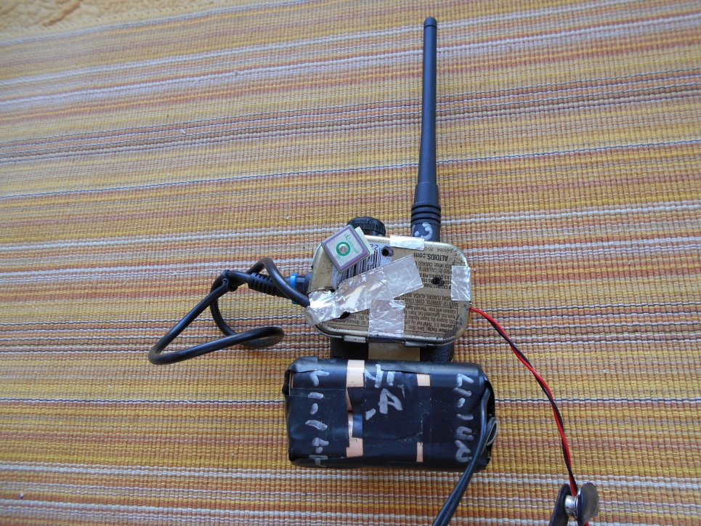
APRS Tracker
You can easily set up a small transmit only APRS station.
This unit uses a Baofeng UV-3R
An Argent Data Systems: OpenTracker (tracker)
UBLOX GPS-R
Li Ion Batteries

Slide 18
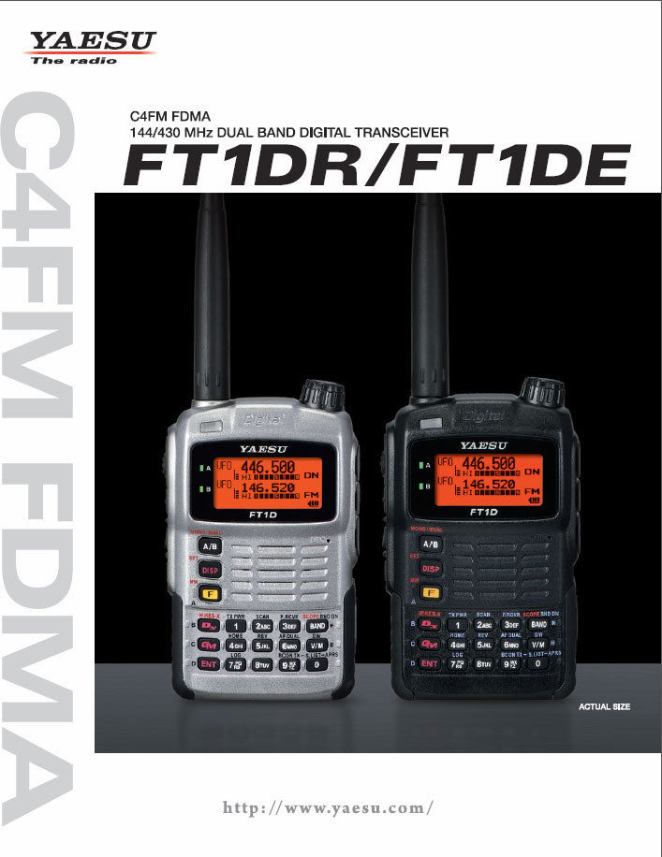
“In the box APRS ready radios”
There are now a few commercially available radios that have built a built in GPS and APRS.
Kenwood: TH-D72,D710G,TH-D74A
Yaesu: VX-8DR and FTM-400DR, FT-1DR, FT2DR

Slide 19
Web links
Web pages
https://www.argentdata.com/catalog/index.php?cPath=22&osCsid=7xPg27mqPqrQv23
http://www.tnc-x.com/TNCPi.htm
http://www.byonics.com/
Questions?

Slide 20
Backup
Cost for APRS Tracker
Argent Data T3-Mini $40.00
Baofeng UV-3R $22.97
UBLOX NEO-6M GPS Module $7.99
TOTAL ~ $70.96

